Slide 1





Laura Corazza
Universities for Adaptation: nature-based solutions and skills for resilience
Italy Pavilion
November 15th 2025
Delegate for Sustainability, University of Turin
Nature-based solutions and collaborative approaches: UniTo and UNITA

Slide 2
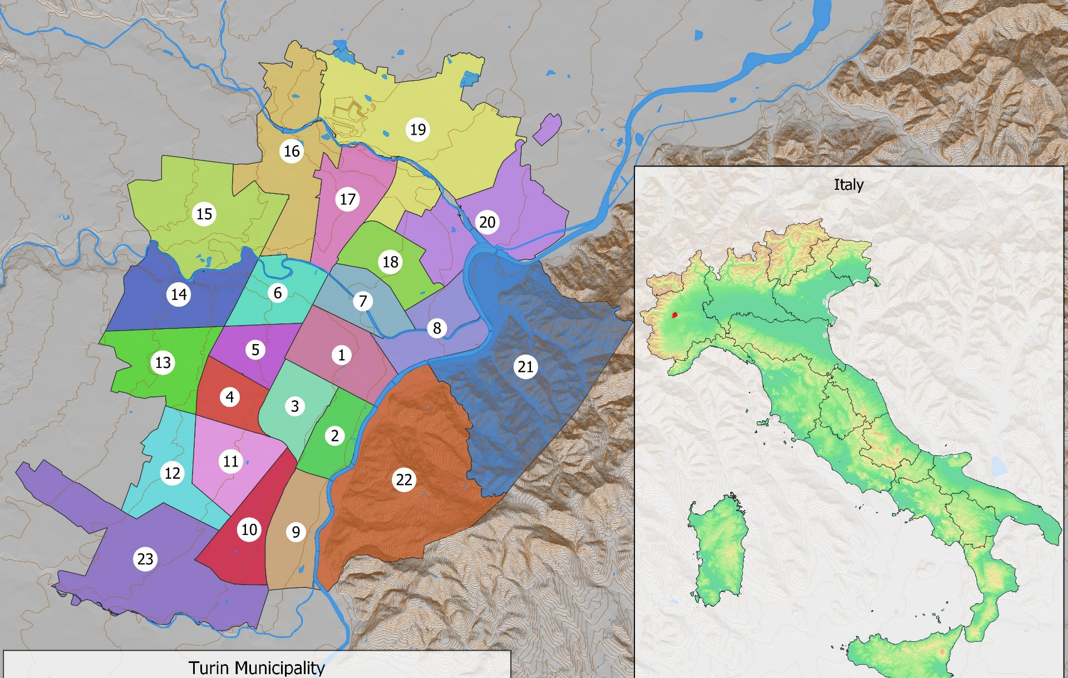
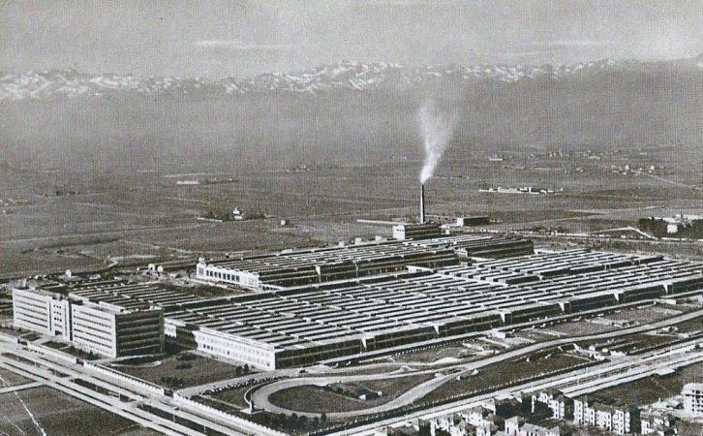
Welcome to Turin—a city in northwestern Italy, located approximately two hours by train from Milan. The southern part of the city, specifically the Mirafiori district, still hosts the now-decommissioned FIAT factories. UNITO is one of the oldest Italian University and one of the largest Founded in 1404 83.000 enrolled students 4550 teaching and administrative staff

Slide 3
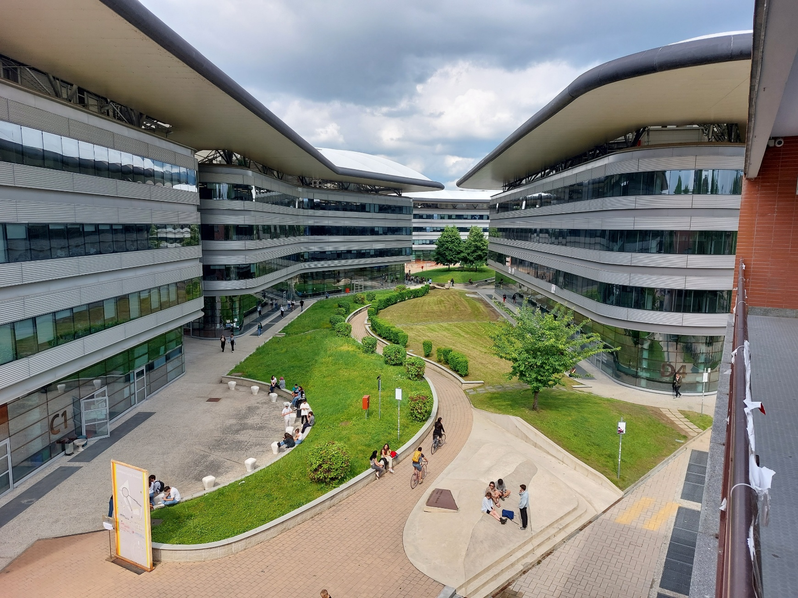
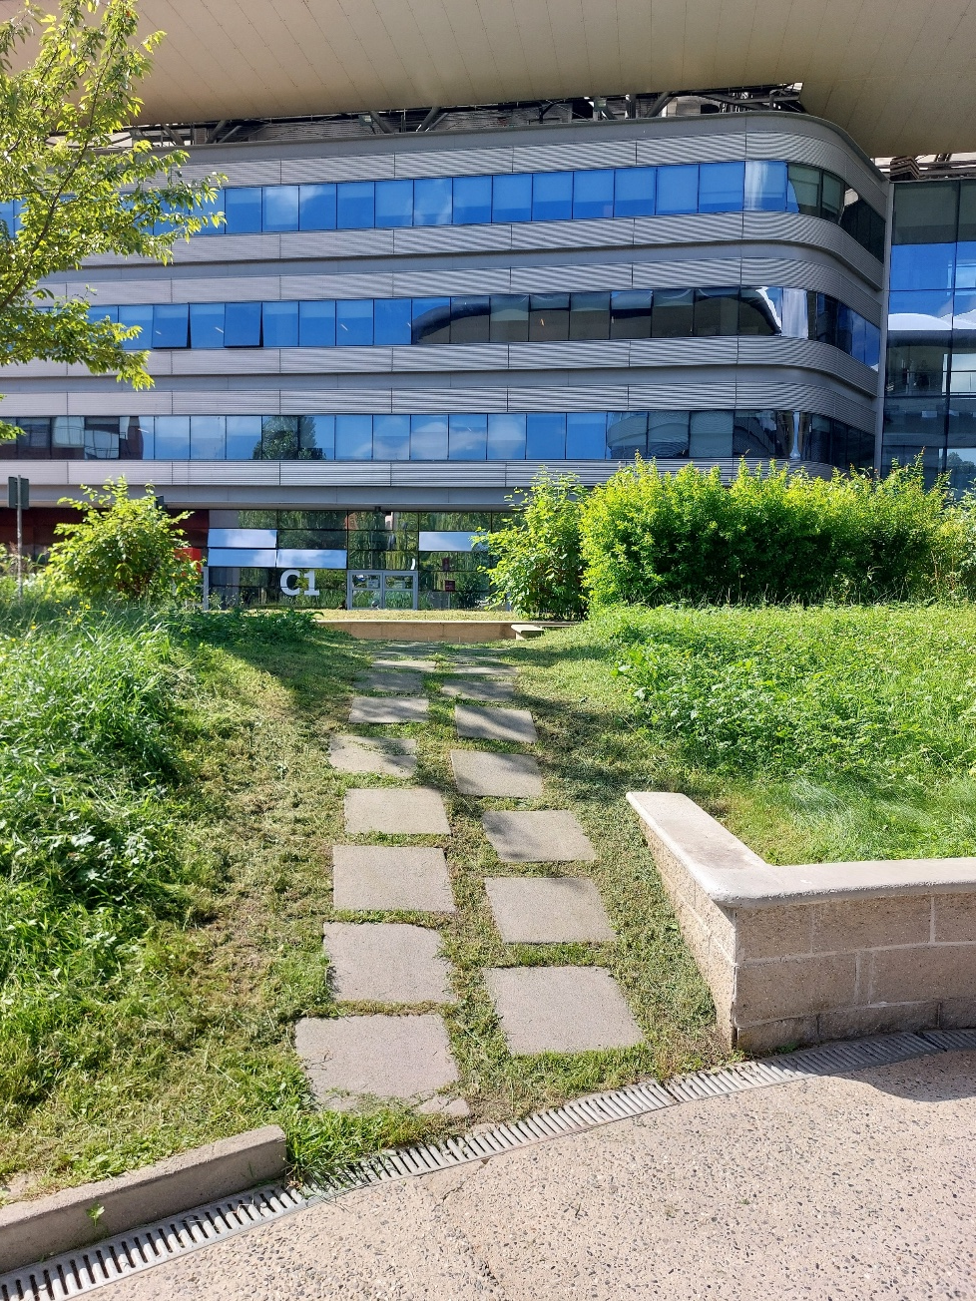
Green Asset Management
Notes:
Progetto di gestione del verde universitario innovativa: sfalcio alternato presso il CLE per mantenere un livello di biodiversità più alto durante tutto l’anno.

Slide 4

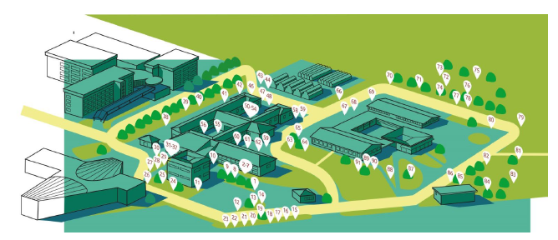
Botanical garden and AgroVet
Community engagement
Students engagement
Citizens science
Young generation education for climate change and nature-based solutions

Slide 5
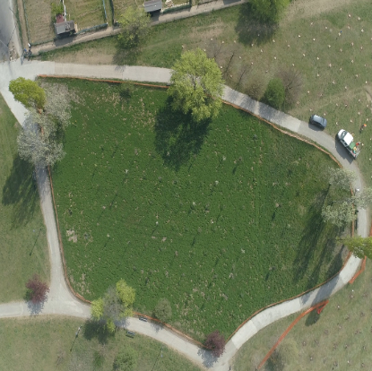
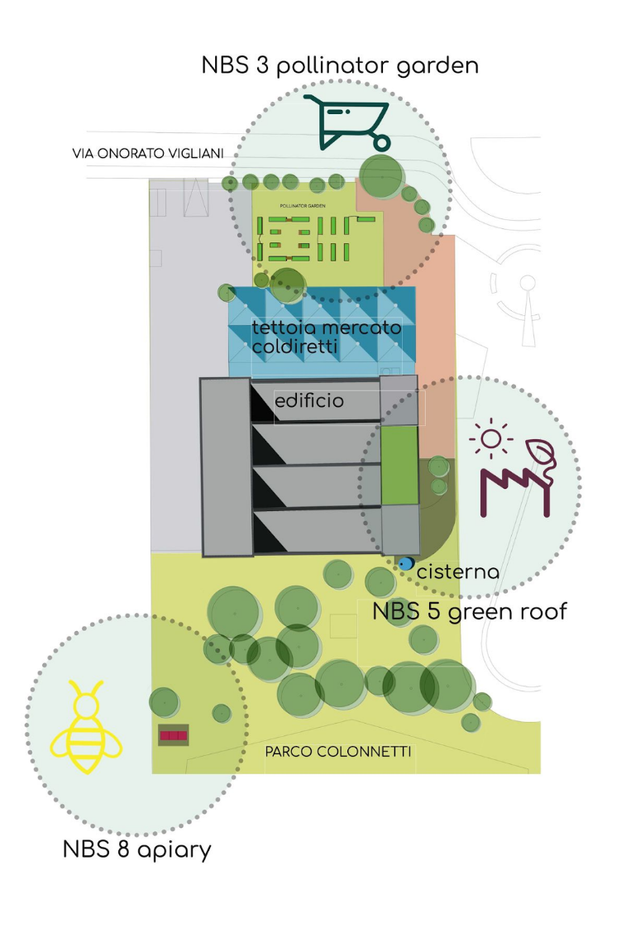


Examples of research projects
ProGIreg (Productive Green Infrastructures for post-industrial urban Regeneration)
8 types of NBS solutions in the City and for the City

Slide 6
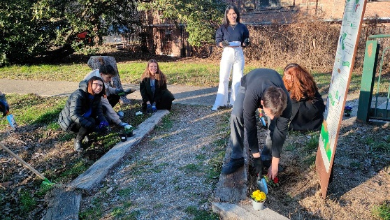
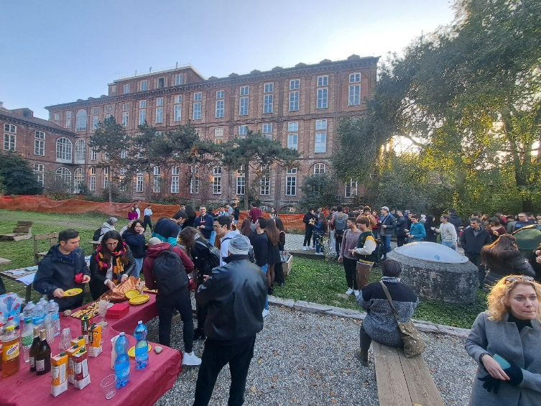
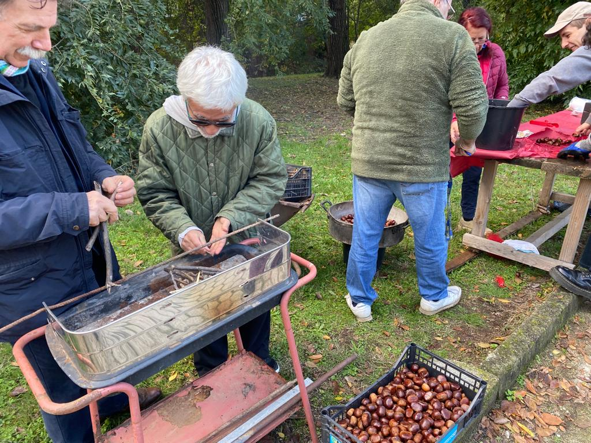
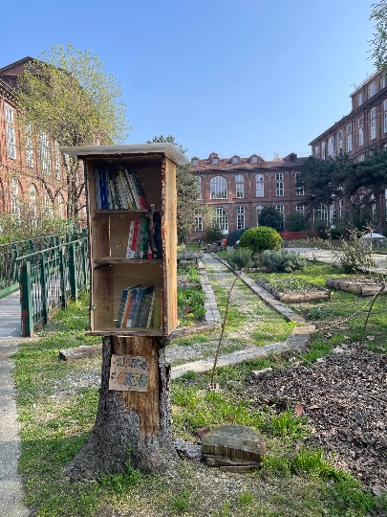
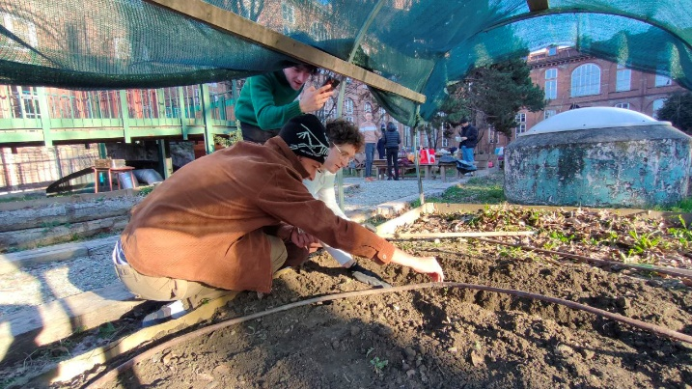
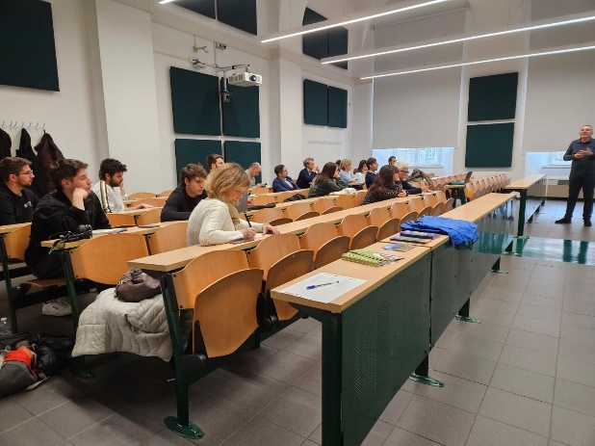
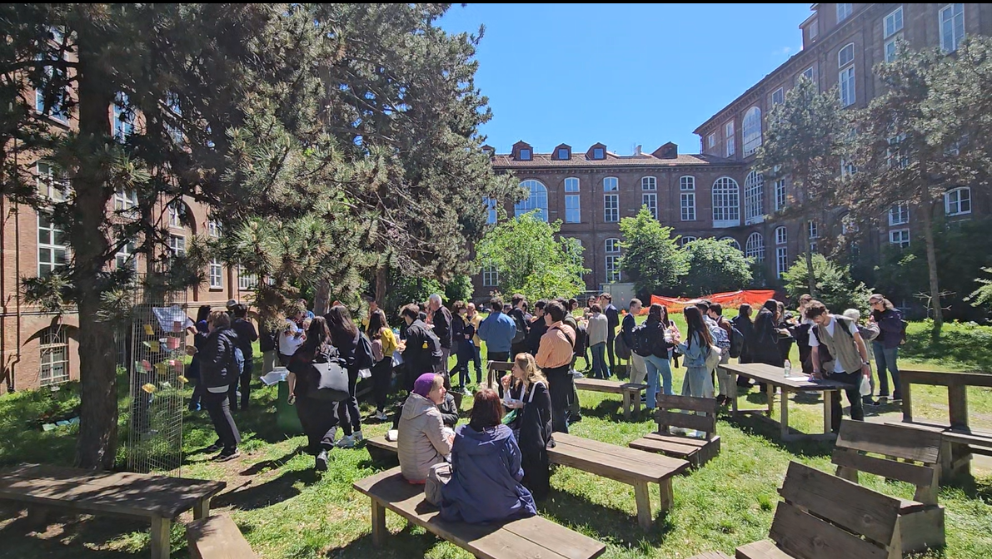
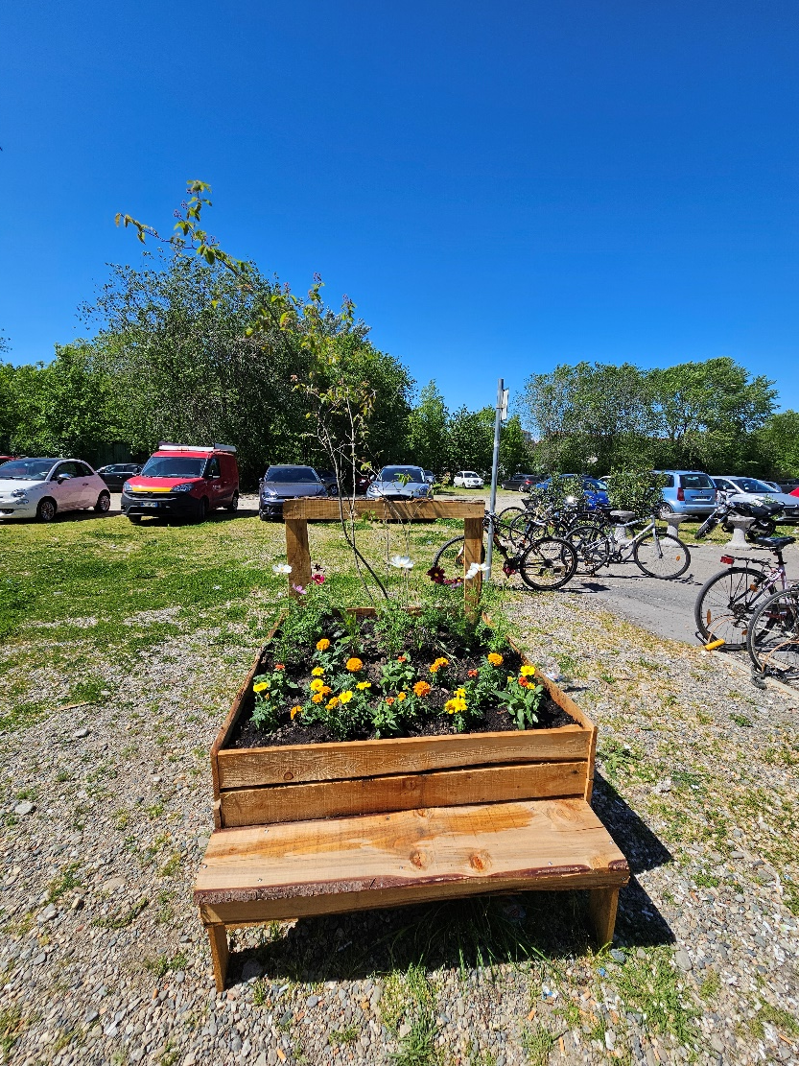
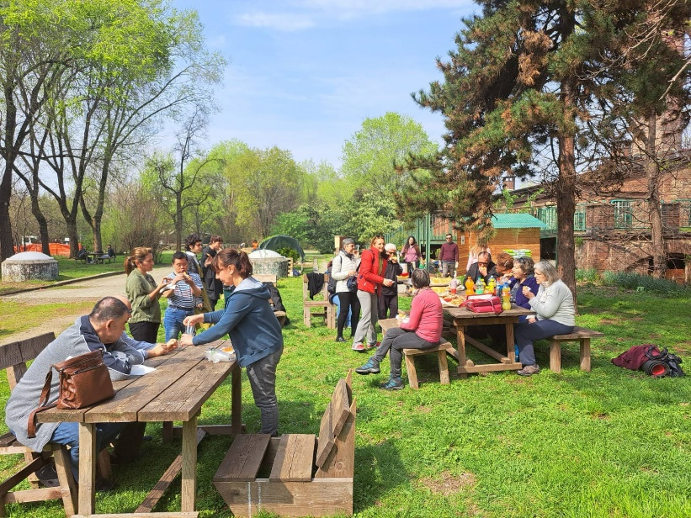
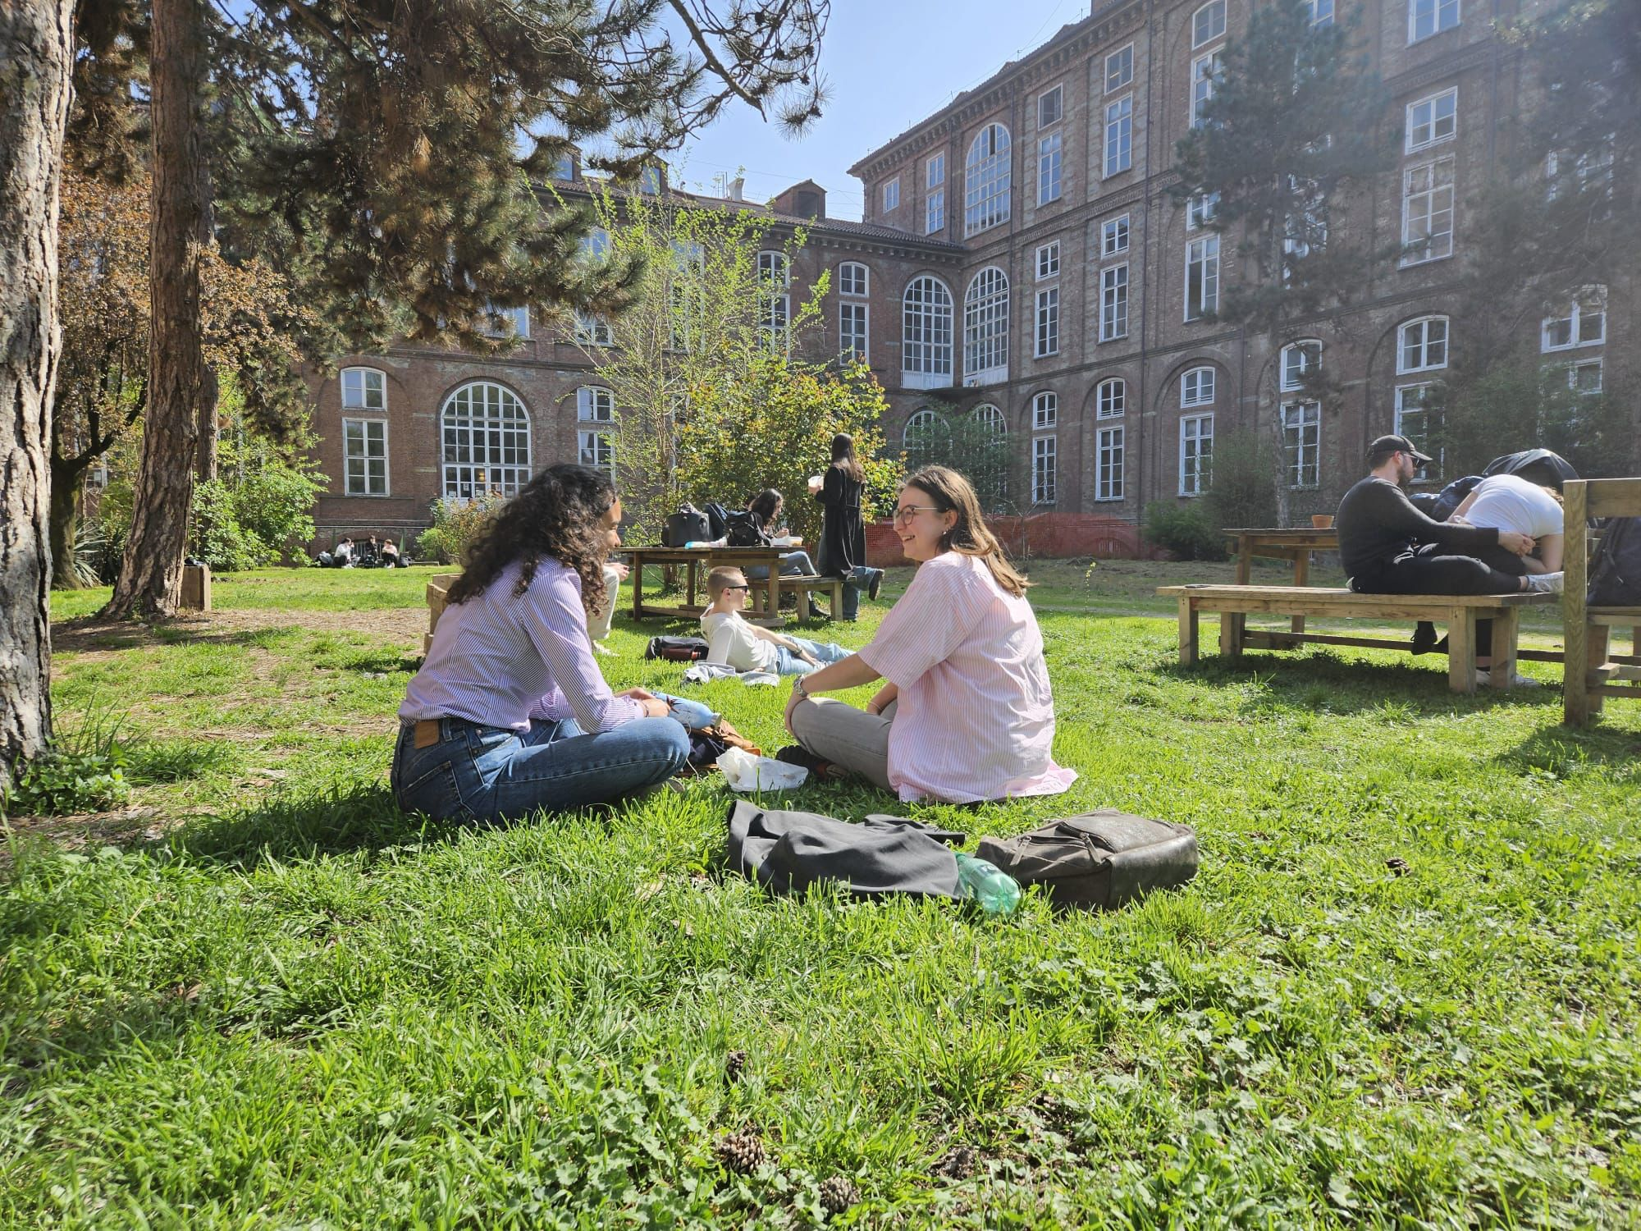
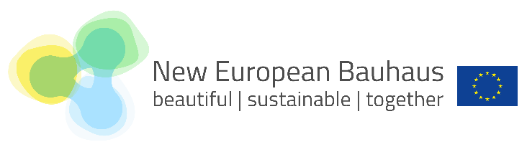
Living Corridor at the School of Management and Economics
Notes:
Progetto di gestione del verde universitario innovativa: sfalcio alternato presso il CLE per mantenere un livello di biodiversità più alto durante tutto l’anno.

Slide 7
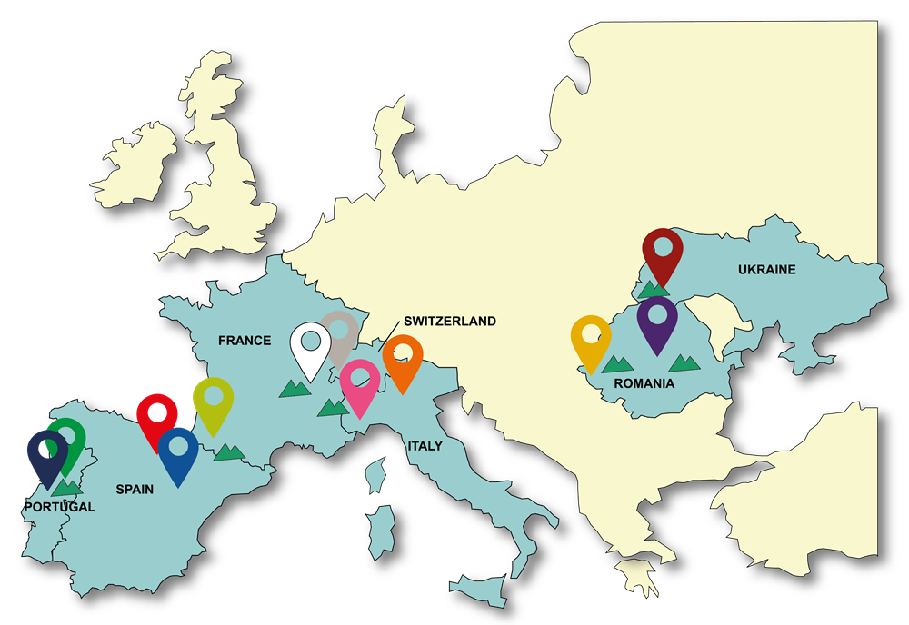
UNITA Alliance
UNITA-Universitas Montium
An alliance of 11 universities and a legal entity (UNITA GEIE) from seven countries with different sizes and trajectories gathering together nearly 250,000 students and 21,000 staff members.
UNITA & Green Sustainability
A context of exchange and growth for the university communities where:
Share best practices in green sustainability practices (emissions inventories, green events management, low carbon mobility)
Foster and integrate sustainability in education (green curricula)
Promote the culture of sustainability within the University community (UNITA Green day, Best green thesis awards…)
Notes:
Progetto di gestione del verde universitario innovativa: sfalcio alternato presso il CLE per mantenere un livello di biodiversità più alto durante tutto l’anno.

Slide 8
