Slide 1



Mario Ravera
Universities for Adaptation: nature-based solutions and skills for resilience
Italy Pavilion
November 15th 2025
Politecnico di Torino
Universities and Climate change adaptation

Slide 2

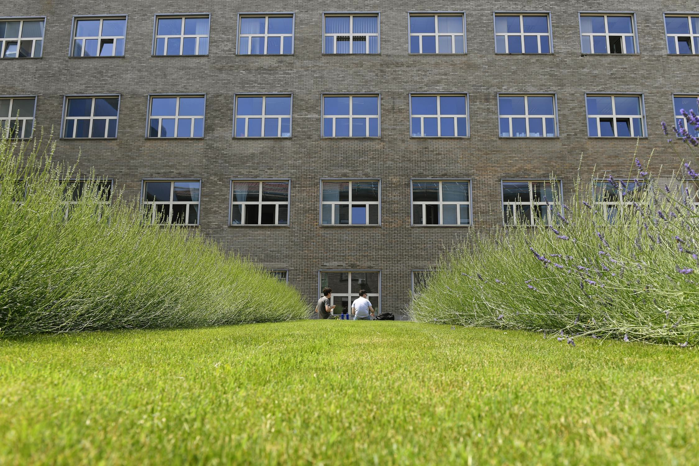


Universities and Climate change adaptation

Slide 3
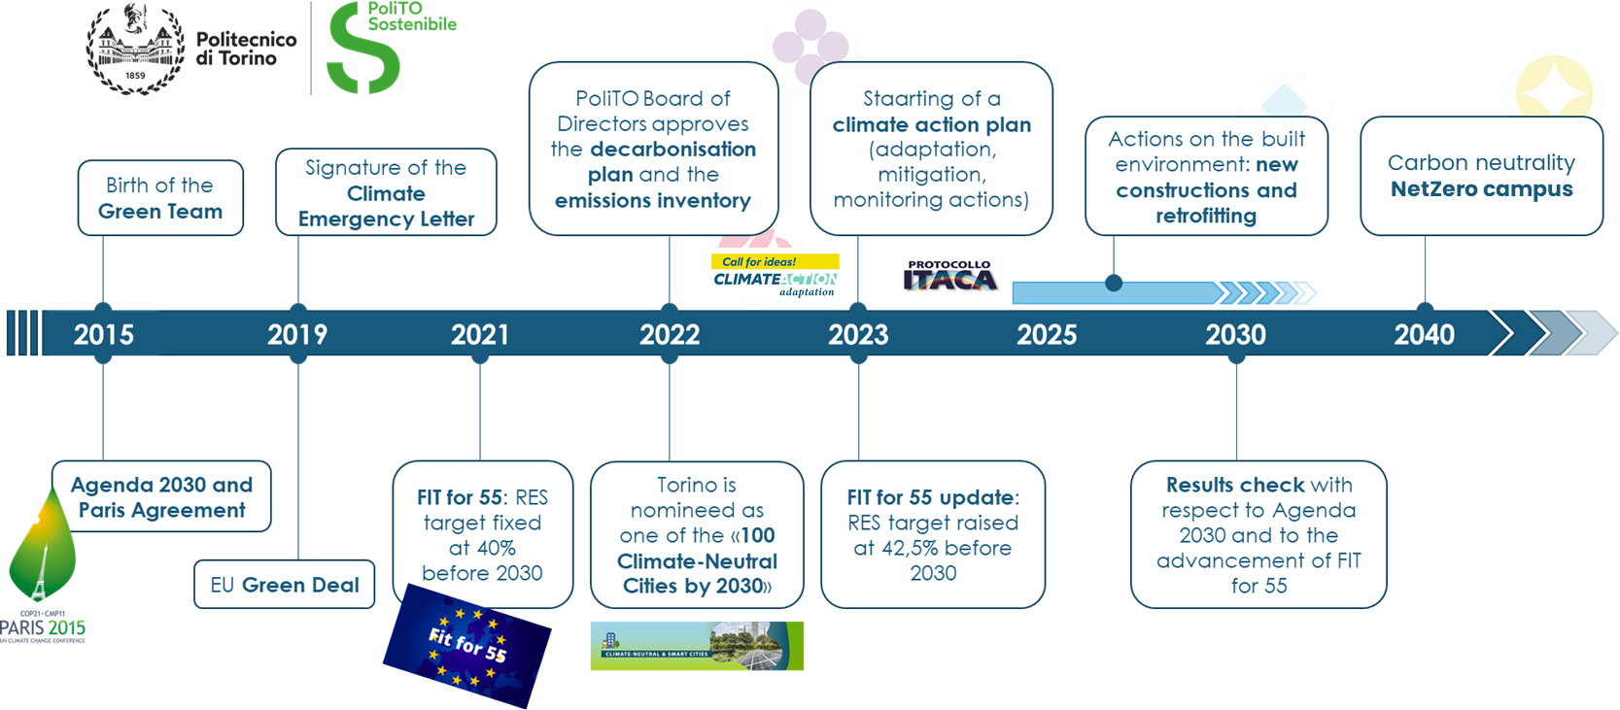
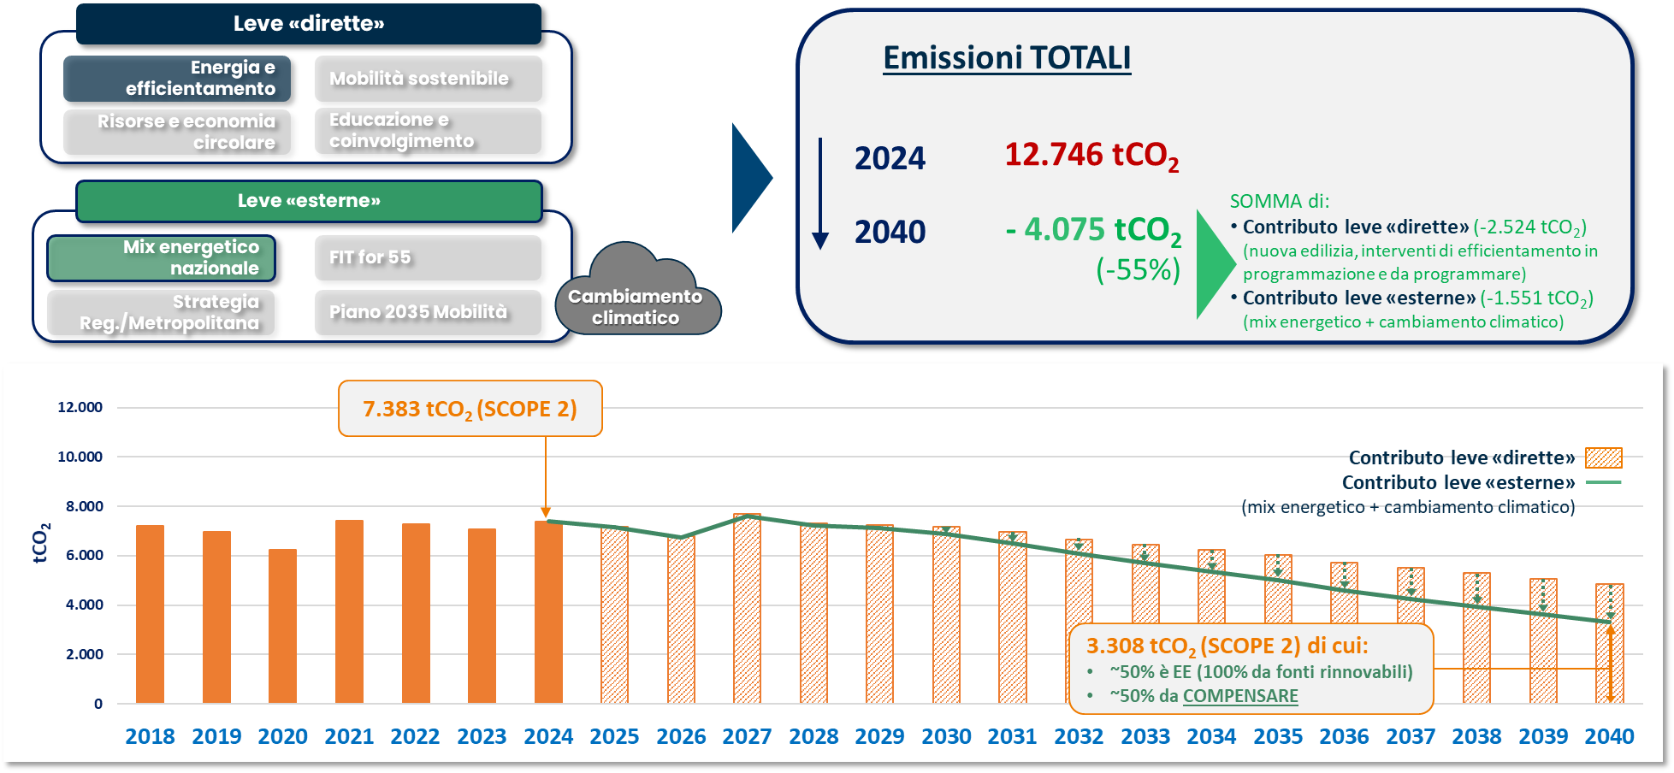
Universities: mitigation and adaptation
A lot of effort for mitigation (mainly decarbonization) actions, => huge constraints and long realization times
Decarbonization targets (just for the university) hardly manage the net zero goal
but
even if universities do their part, the global context is having the biggest impact and universities will need to adapt
Mitigation roadmap
Decarbonization targets

Slide 4


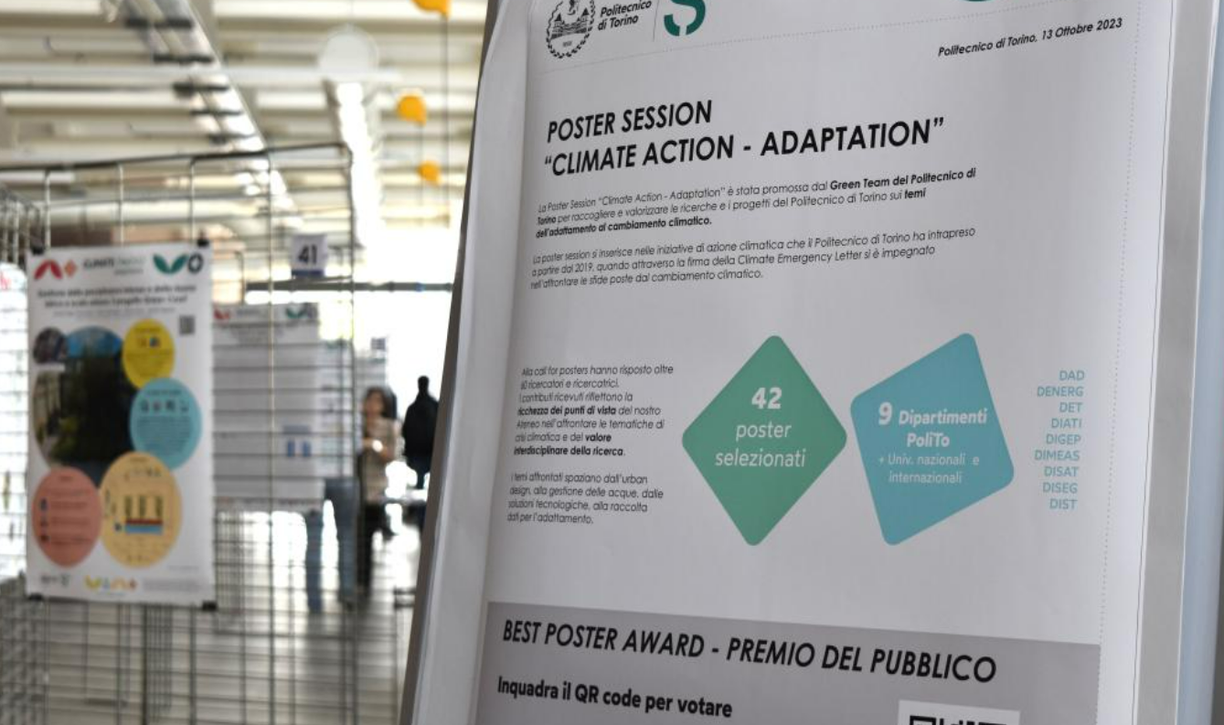
What is adaptation for a university?
Three hints:
to fund new university buildings, the EIB, asked about the climate change risk mitigation actions
A photo context involving the students highlighted a high variety of «eco-anxiety» issues that can be addressed
A CC adaptation researcher call for posters and call for ideas was source of great ideas that covered different action fields

Slide 5
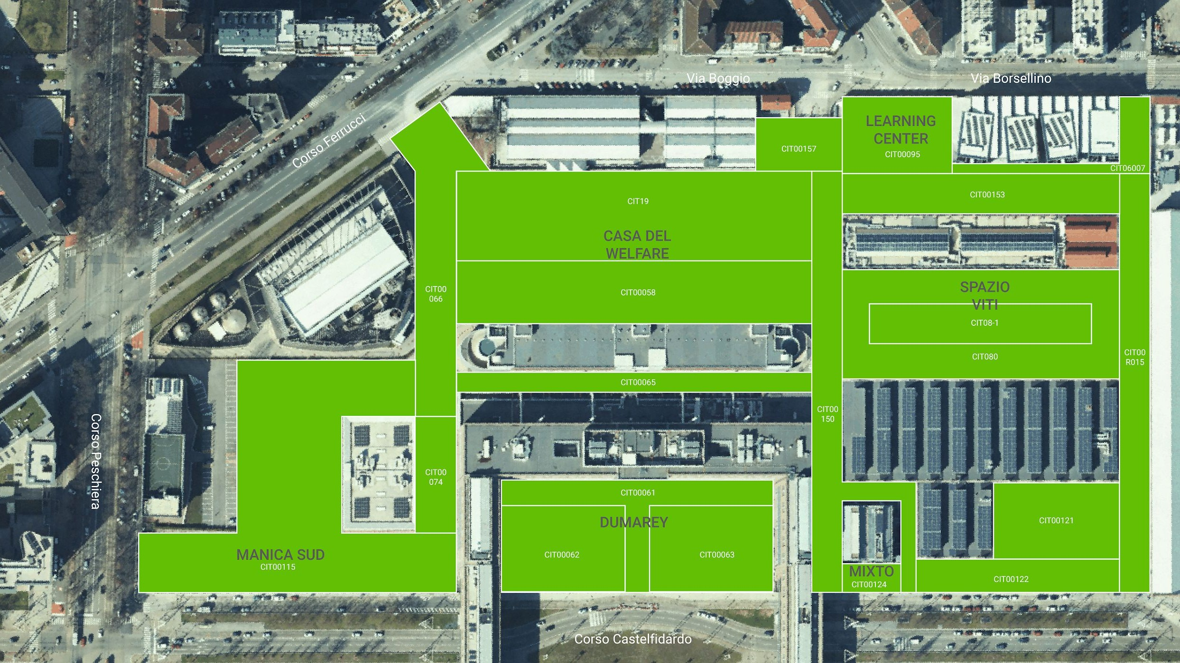

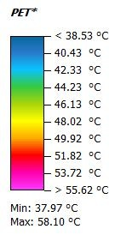
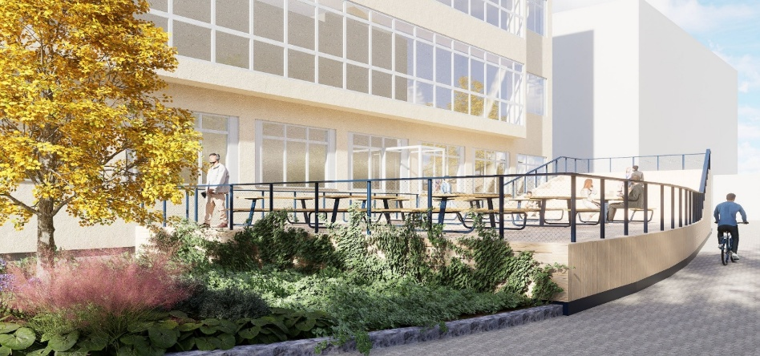
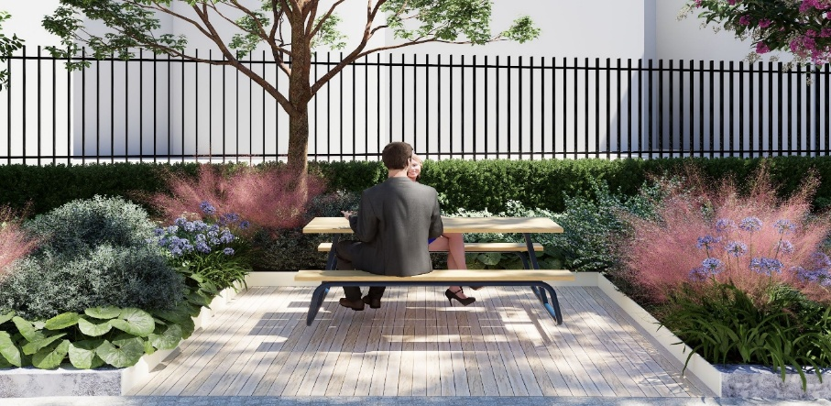
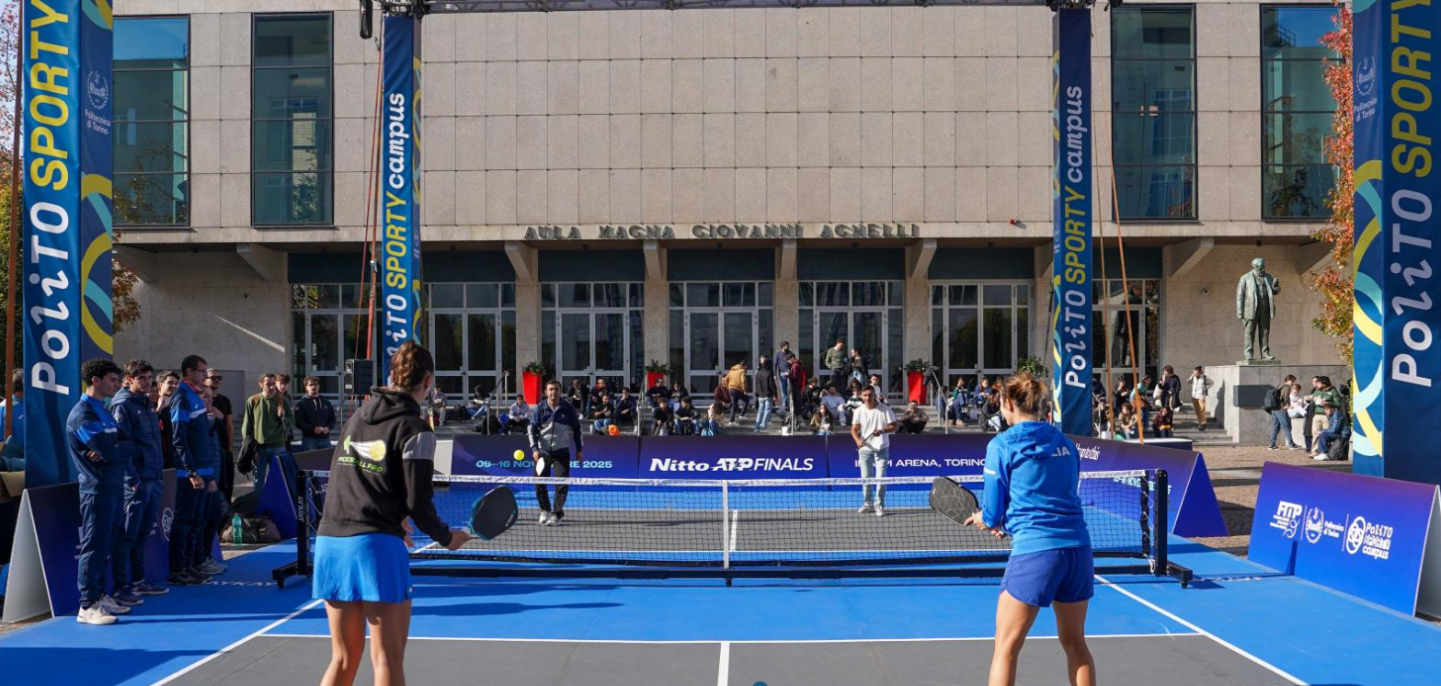
The identified main action fields
Built environment
Identification of «heat islands» and mitigation actions
Flexibilisation in heating/cooling system (within given ranges)
Increased spaces for staying at university during all day and minimize commuting;
Feel-at-home spaces for study, relax and sport activities
Green environment
University services

Slide 6
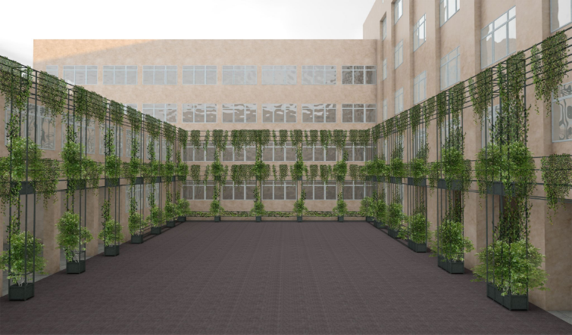
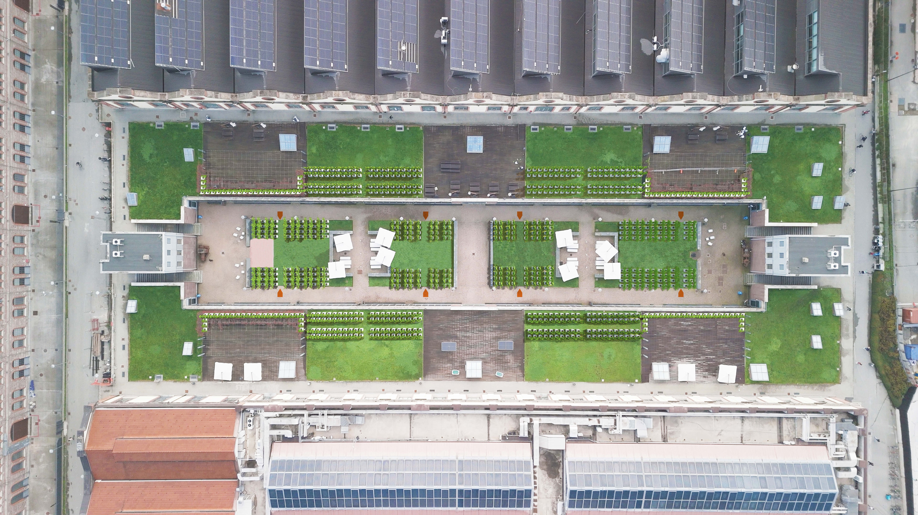
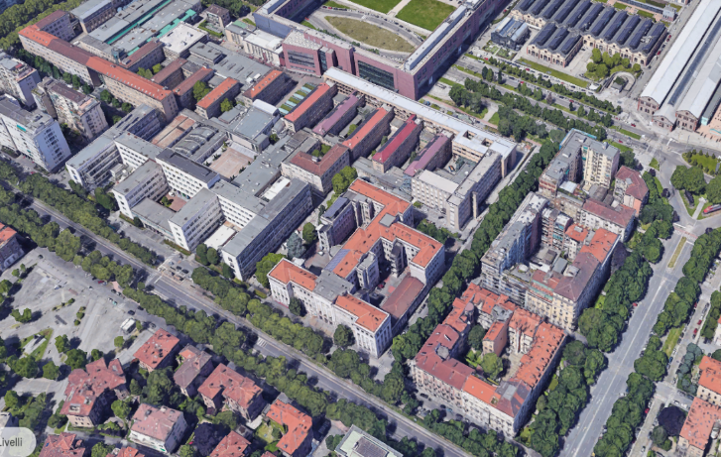
The identified main action fields
Built environment
Green environment
Increase of green areas and liveable green spaces
Walking and sport paths creation
University services
B
A

Slide 7
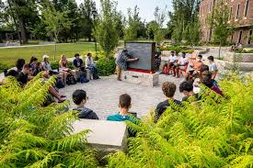
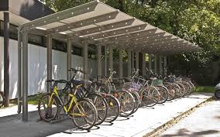
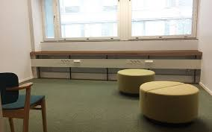


The identified main action fields
Built environment
Green environment
University services
Improvement of mobility services (including space for bikes)
Quiet rooms, cool spaces
Essential goods shops in the university
Increase of community spaces
Support for anxiety,

Slide 8
Next focus: the adaptation and mitigation plan
The adaptation and mitigation plan is not yet a standard practice and is not yet seen as key plan for the university development strategy
Key stakeholder involvement is limited
No dedicated budget
Non overall coordinated plan

Slide 9
Thank you for your attention

