Slide 1
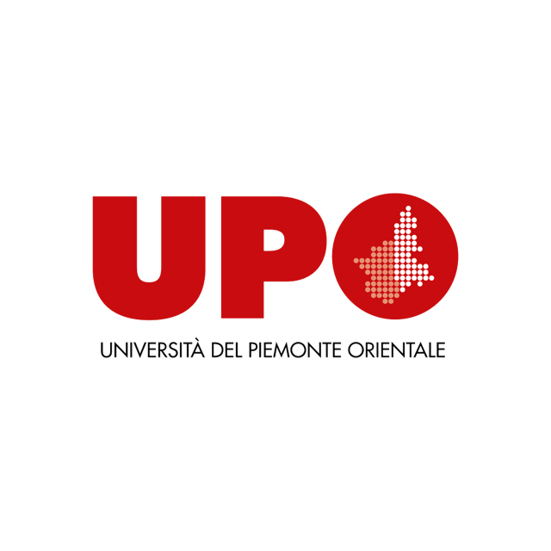


Carmen Aina
Universities for Adaptation: nature-based solutions and skills for resilience
Italy Pavilion
November 15th 2025
Università del Piemonte Orientale
Campus to Climate Action: The Role of Universities in a Changing Climate

Slide 2


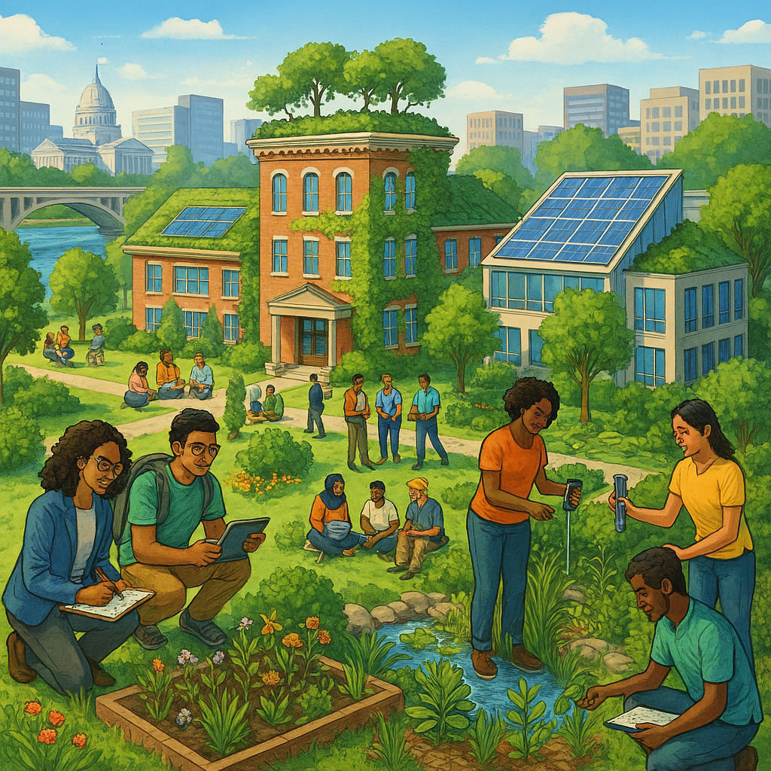



Why Universities Matter for Adaptation
Trusted Facilitators
Mission-driven institutions that bring together government, business, and civil society for collaborative action.
Green Skills at Scale
Unique capability to build climate competencies across the entire education pipeline, from schools to doctoral programs.
Living Laboratories
Campus infrastructure serves as testbeds for nature-based solutions, monitoring protocols, and policy feedback.
Community Engagement
Platforms that shift social norms, reduce polarization, and build collective capacity for climate action.
Notes:
Universities possess a unique comparative advantage in addressing climate adaptation. Unlike other institutions, we serve as trusted conveners that bring together diverse stakeholders—government agencies, private enterprises, and civil society organizations. Our mission extends beyond profit or political cycles; we are committed to long-term societal benefit.
We have the infrastructure and expertise to build green skills at scale, from primary education partnerships to doctoral training. Our campuses serve as living laboratories where nature-based solutions can be prototyped, monitored, and refined before scaling. Perhaps most importantly, we engage communities in ways that reduce polarization and build the social capital necessary for collective climate action.
Adaptation requires not just technical solutions, but cultural transformation—and universities are uniquely equipped to deliver both. We bridge the gap between knowledge generation and practical implementation, between short-term political cycles and long-term sustainability goals, between individual interests and collective well-being.

Slide 3

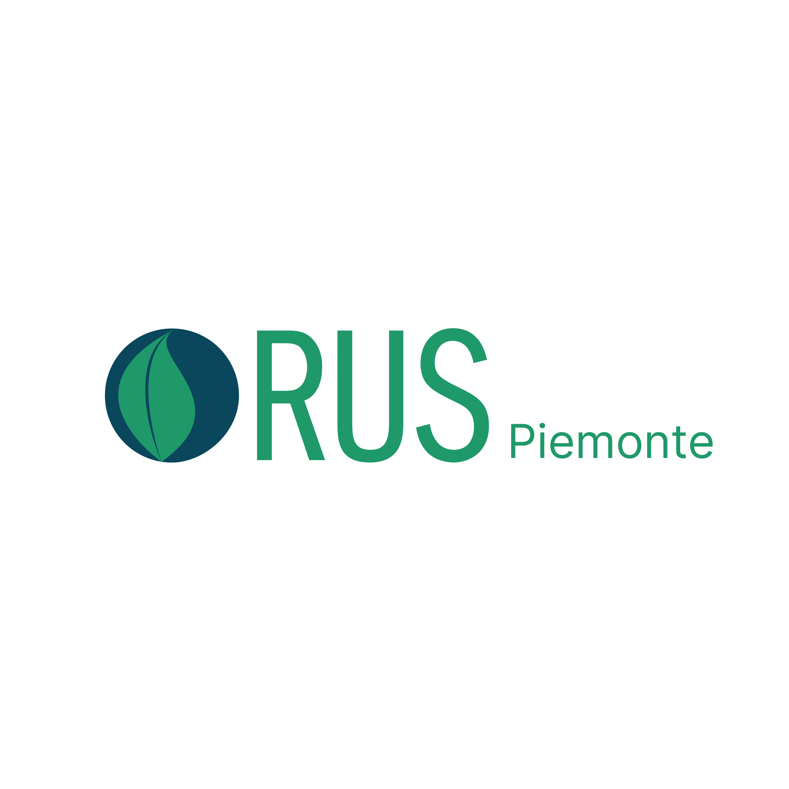



Whole-University Approach to Sustainability at UPO
RUS Network Membership
Member of Rete delle Università per lo Sviluppo Sostenibile—Italian Network of Universities for Sustainable Development.
Peer learning through working groups enables rapid diffusion of best practices.
RUS Piemonte Leadership
Co-founder and Chair (2023–2026) of RUS Piemonte regional sub-network. Intensifies territorial collaboration and creates spillover effects that multiply collective impact.
Systematic SDG Mapping
All Third Mission activities and research outputs mapped to Sustainable Development Goals for accountability, prioritization, and partner attraction.
Notes:
At UPO, we have embraced a whole-university approach to sustainability that extends beyond isolated projects to systemic transformation. Our membership in RUS—the Italian Network of Universities for Sustainable Development—connects us to a community of practice where we share innovations and learn from peer institutions across Italy.
Recognizing that sustainability challenges are inherently territorial, we co-founded RUS Piemonte with other Piedmont universities, and I currently serve as Chair for the 2023–2026 term. This regional sub-network intensifies collaboration and creates spillover effects that multiply our collective impact. When one university develops an effective practice, the network enables rapid diffusion and adaptation to different contexts.
Critically, we have implemented systematic SDG mapping of all our Third Mission activities and research outputs. This is not just bureaucratic compliance—it provides a clear evidence base showing where we are making progress, where gaps exist, and how to prioritize resources. This measurement discipline is essential for accountability and for attracting partners and investors who want to see demonstrable impact aligned with Agenda 2030.

Slide 4


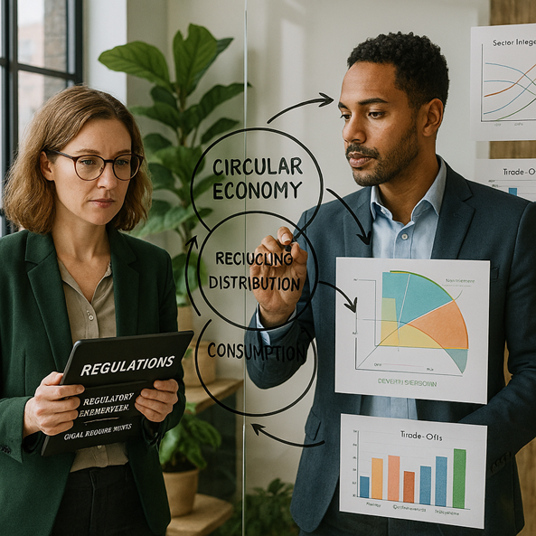


Educating for Green Skills and Resilience
UPO launched a new multidisciplinary Bachelor's degree in Environmental Sciences—Management of Environment and Sustainable Development (GASS). This program breaks down disciplinary silos to prepare professionals for the ecological transition.
Multidisciplinary Integration
Combines environmental science with economics, law, humanities, and medical disciplines for comprehensive sustainability skills.
One Health Approach
Holistic perspective addressing environmental, social, and economic dimensions simultaneously to understand interconnected systems.
Green Jobs Alignment
Direct responsiveness to growing labor market demand for circular economy expertise and ecological transition management.
Notes:
The ecological transition demands a new generation of professionals with interdisciplinary competencies. Traditional siloed education no longer suffices when addressing complex sustainability challenges that span environmental, economic, social, and health dimensions.
That is why we launched GASS—our multidisciplinary Bachelor's degree in Environmental Sciences with a focus on Management of Environment and Sustainable Development. This program breaks down disciplinary barriers by integrating environmental science with economics, law, humanities, and medicine. We have adopted a One Health approach that recognizes the interconnection between planetary health, human health, and economic systems.
This is not just pedagogical innovation—it is a direct response to labor market transformation. Green jobs are the fastest-growing employment sector, and companies undergoing ecological transition need professionals who can navigate trade-offs, understand regulatory frameworks, communicate with diverse stakeholders, and design circular economy business models.
Our graduates leave with both technical expertise and the systems thinking required to lead sustainability transformations in any sector. They understand that environmental challenges cannot be solved through environmental science alone—they require integrated solutions that address economic viability, social equity, legal frameworks, and public health simultaneously.

Slide 5

Institutional Innovation for Sustainability
New Department Created
Breaking Silos
Established Department for Sustainable Development and Ecological Transition to embed sustainability into institutional DNA and governance structures.
Research teams organized around problems and solutions, not only disciplines, enabling genuine interdisciplinary collaboration from project inception.
Holistic Problem-Solving
Co-Creation Partnerships
Systematizing shared knowledge across fields to generate creative solutions to complex global sustainability challenges.
Working alongside enterprises and public institutions from the beginning to ensure research addresses real-world needs and can be scaled.
Notes:
Sustainability cannot be achieved through incremental adjustments to existing structures—it requires fundamental governance reform. UPO has taken the bold step of creating a new Department for Sustainable Development and Ecological Transition. This is not simply a rebranding exercise. We have fundamentally reorganized how research teams are formed and incentivized.
Instead of organizing solely by traditional disciplines, we now organize around problems and solutions. This structure enables researchers from diverse fields to collaborate from project inception rather than attempting to integrate findings after the fact. The result is systematized shared knowledge that generates genuinely creative solutions to complex problems.
Importantly, this department operates through co-creation partnerships with enterprises and public institutions. We do not develop solutions in isolation and then seek applications—we work alongside businesses and government agencies from the beginning to ensure our research addresses real-world needs and can be scaled.
This governance shift embeds sustainability into our institutional DNA and creates the conditions for transformative rather than incremental change. It signals to faculty, students, and external partners that sustainability is not a peripheral concern but central to our mission and organizational structure.

Slide 6

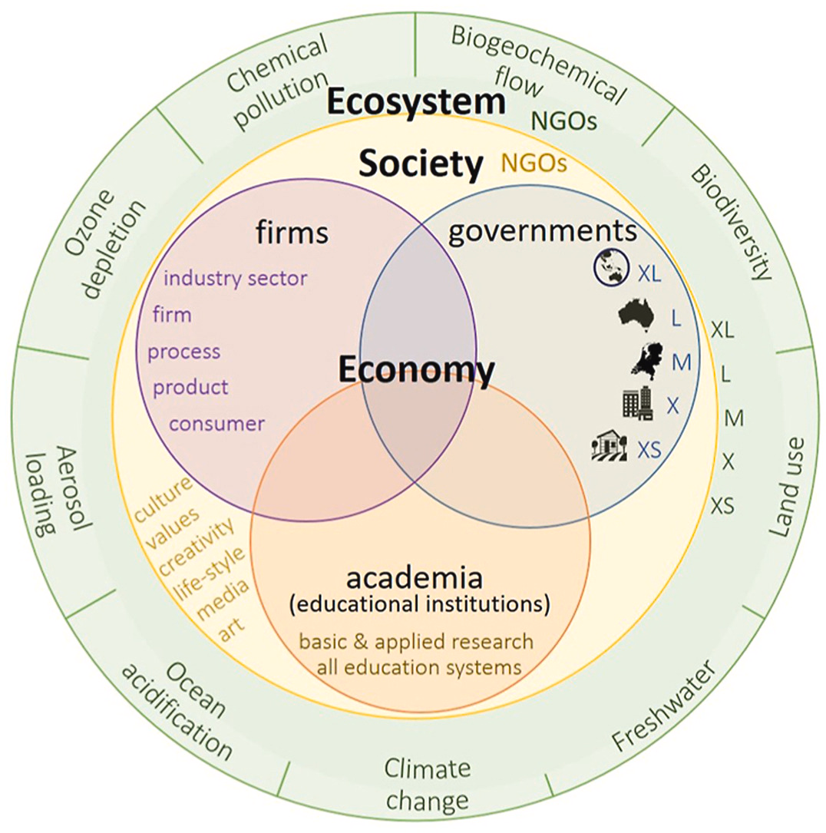



From Research to Practice: The Circularity Desk
The Circularity Desk positions the university as a service platform for the entrepreneurial ecosystem, providing open support for firms to transition to sustainable circular economy models.
Diagnostics
Comprehensive assessment of current resource flows, waste streams, and circular economy readiness for businesses.
Applied Research
University researchers collaborate with firms to develop evidence-based sustainable solutions tailored to specific operational contexts.
Roadmapping
Customized transition plans for resource efficiency, circular business models, and ecological transformation strategies.
Notes:
The image is from: The circular economy operating and stakeholder model “eco-5HM” to avoid circular fallacies that prevent sustainability
Author links open overlay panelBart J.A. van Bueren, Kevin Argus, Usha Iyer-Raniga, Mark A.A.M. Leenders
Knowledge generation without practical application fails to deliver the transformation we need. That is why UPO created the Circularity Desk—an open support platform where firms, especially small and medium enterprises, can access university expertise to identify, pilot, and scale sustainable solutions.
The Desk provides applied research, diagnostics, and customized roadmaps for improving resource efficiency and transitioning to circular business models. This is not traditional consulting—it is a partnership model where university researchers work alongside business leaders to co-develop solutions grounded in scientific evidence but tailored to specific operational contexts.
Many SMEs want to embrace sustainability but lack the internal capacity for complex systems analysis or life-cycle assessment. The Circularity Desk fills this gap, positioning the university as a service platform for the entrepreneurial ecosystem. We help businesses identify waste streams that can become resource inputs, redesign products for durability and recyclability, and develop business models that decouple revenue from resource consumption.
This model is highly replicable and demonstrates how universities can accelerate the ecological transition beyond campus boundaries by supporting the businesses that drive economic activity and employment in our regions. When we help local enterprises become more sustainable, we multiply our impact throughout the entire economic ecosystem.

Slide 7


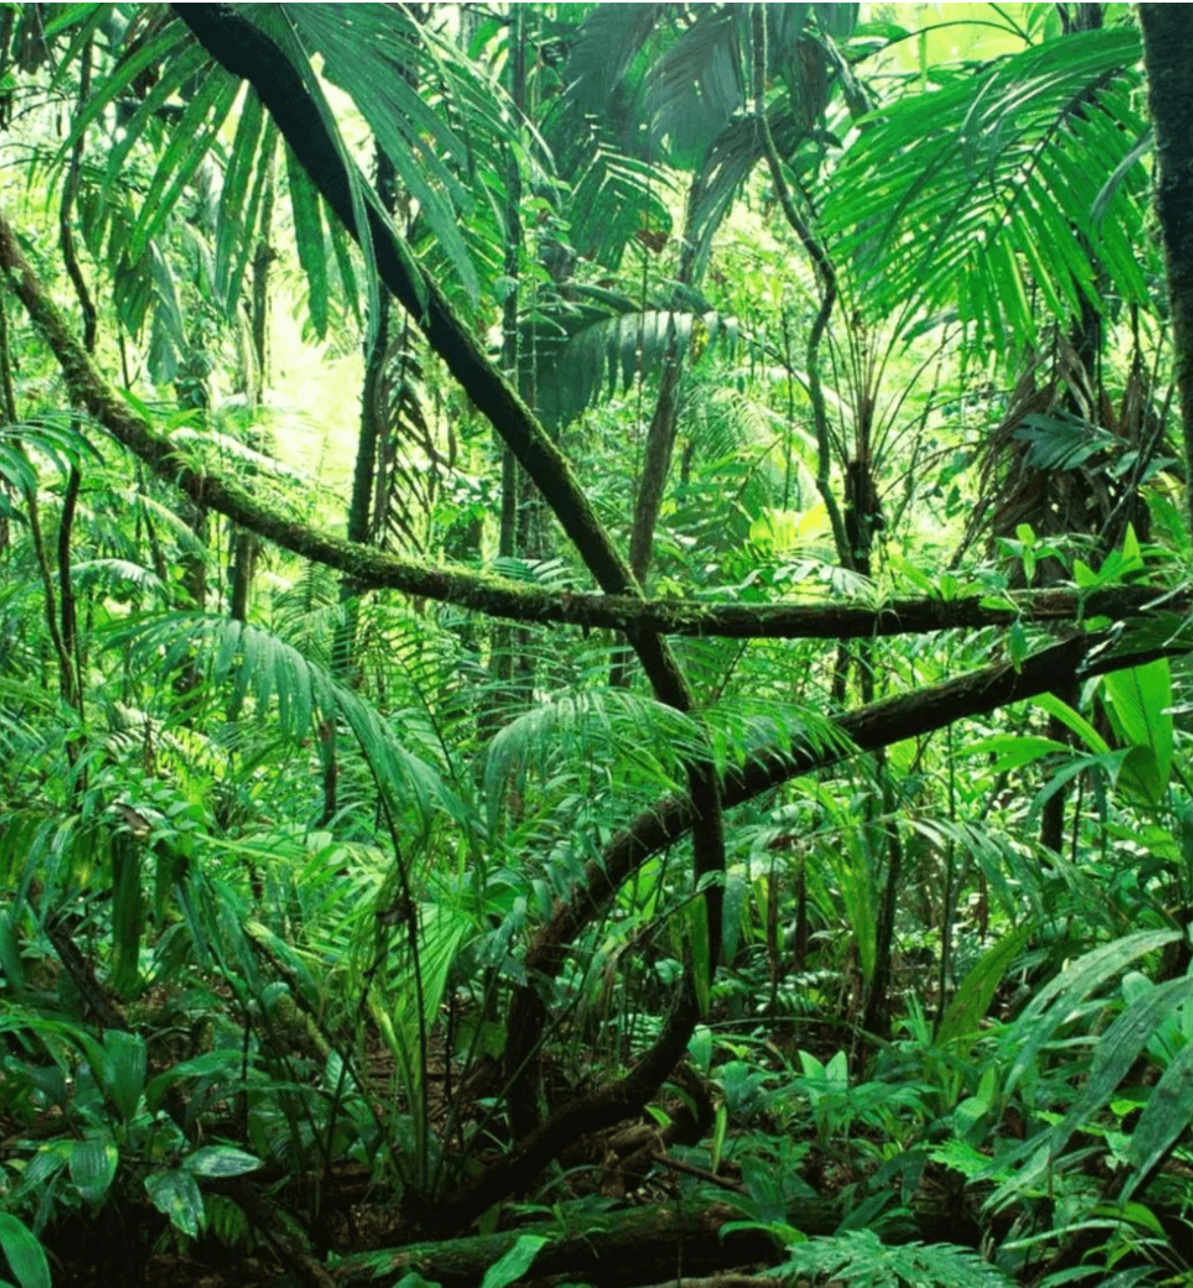



Nature-based Solutions: The UPO Forest
Living Laboratories in Italy and Ecuador for Biodiversity Conservation
Tri-Party Agreement
Signed October 8, 2025: UPO, Fondazione Otonga (Ecuador), and Ananda Giri APS (Guardabosone, Italy) collaborate to create mirrored study plots for comparative research and student mobility.
Italy Site: Guardabosone
One hectare of forest with apiary in Piedmont's internal areas. Serves as accessible field laboratory for local biodiversity monitoring and hands-on student training.
Ecuador Site: Otongachi Rainforest
One hectare in the Otongachi rainforest—one of Earth's highest biodiversity areas. Provides unparalleled opportunities for studying complex ecosystems and species richness in a globally significant biodiversity hotspot.
Research & Education
Living labs enable immersive fieldwork, knowledge exchange for students and researchers, and global-local bridges connecting territorial heritage with planetary biodiversity conservation.
Notes:
Nature-based solutions are central to climate adaptation, but they require long-term research infrastructure and international collaboration. On October 8, 2025, UPO formalized a groundbreaking tri-party agreement with Fondazione Otonga in Ecuador and Ananda Giri APS in Guardabosone, Italy, creating the UPO Forest initiative.
This establishes two mirrored study plots—each one hectare—serving as living laboratories for biodiversity conservation and field research. In Guardabosone, in the Piedmont region, we have a forest plot with an apiary that allows us to study local biodiversity and ecosystem services while providing accessible training opportunities for our students.
In Ecuador, we have access to one hectare of the Otongachi rainforest, one of the most biodiverse areas on the planet. The Chocó-Andean region is a global biodiversity hotspot where the density of species offers unparalleled research opportunities. This is not symbolic—it is a concrete platform for generating scientific knowledge about ecosystem resilience, testing conservation strategies, and understanding the complex relationships that sustain life in high-biodiversity environments.
These sites enable student and researcher mobility, providing immersive fieldwork experiences that connect our local territorial heritage with global biodiversity hotspots. The pedagogical value of this immersive experience cannot be overstated—students return transformed by direct contact with complex living systems. They develop not just technical skills but a profound understanding of ecological interconnection and the urgency of conservation.

Slide 8


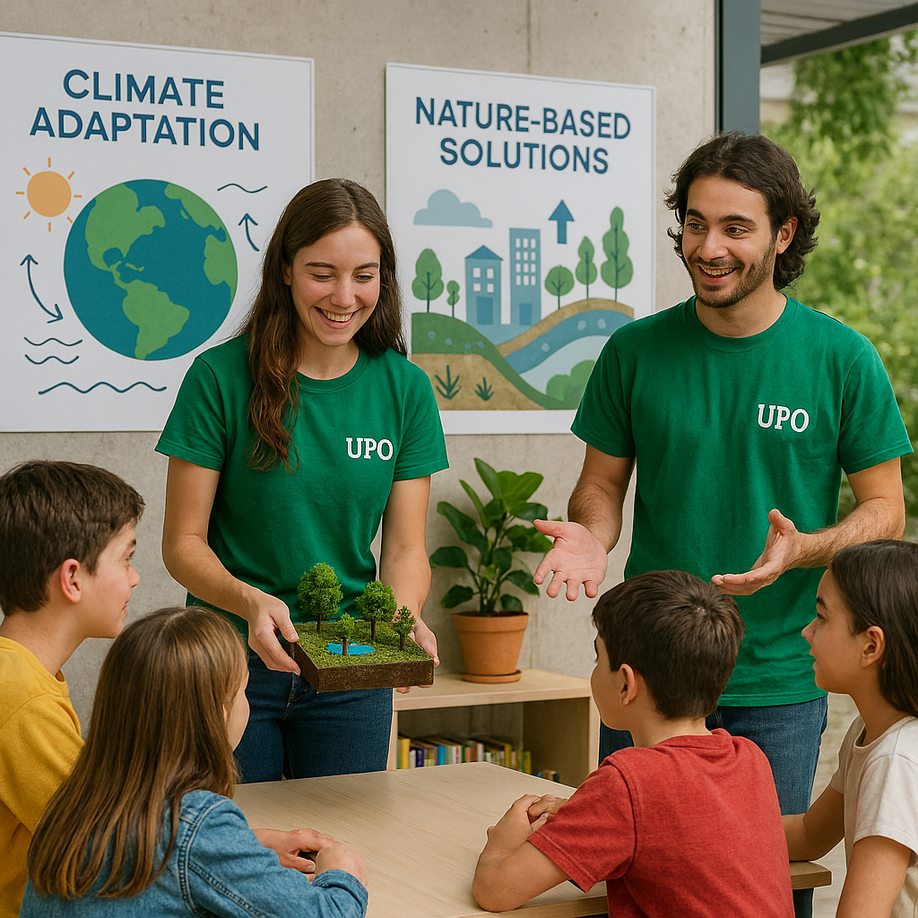
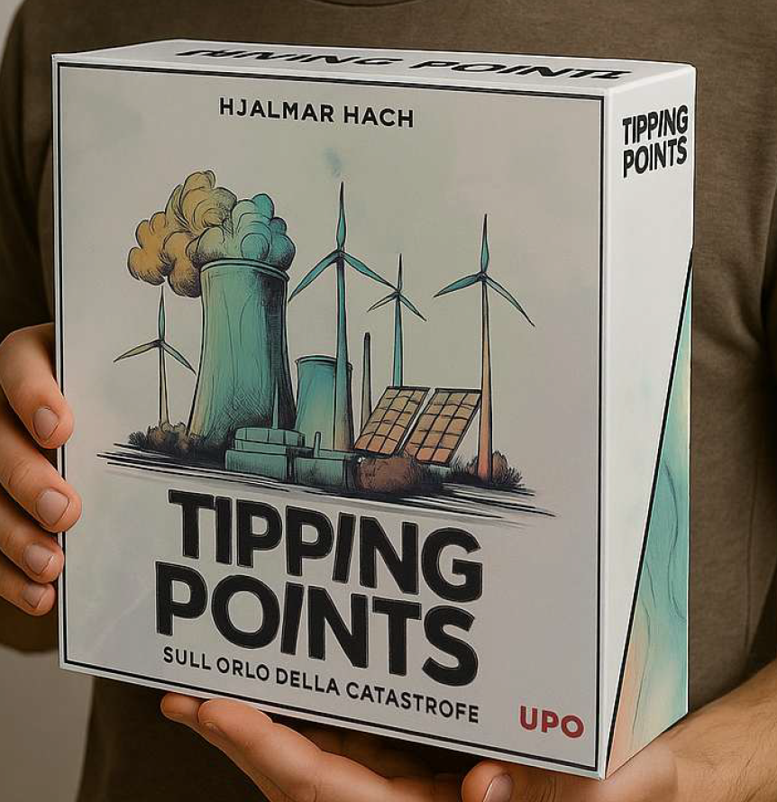


Building a Culture of Sustainability
UPO Junior Outreach
Comprehensive pathways engaging schools and young people across the territory with age-appropriate sustainability concepts and activities.
Tipping Points Climate Game
Experiential strategy game for secondary schools and civil society groups. Participants learn about trade-offs, system complexity, and cooperation through hands-on climate decision-making.
Culture-Building Impact
New languages and interactive methods strengthen climate literacy, reduce polarization, and create dialogue across political and social divides.
Notes:
Technical solutions alone cannot deliver climate adaptation.
UPO engages schools and citizens to transform culture, reduce polarization, and build social capital for collective climate action.
Technical solutions alone cannot deliver climate adaptation—we must also transform culture and build social capital for collective action. UPO has developed comprehensive outreach programs that engage schools and citizens across our territory.
UPO Junior creates pathways for young people to engage with sustainability concepts through age-appropriate activities. But our most innovative tool is "Tipping Points"—an experiential climate strategy game we developed to help participants understand trade-offs, the complexity of decision-making, and the critical importance of cooperation.
This serious game is designed for school-leaving guidance activities in upper secondary schools, but we also use it with civil society groups. Why? Because climate polarization is one of our greatest obstacles to action. When people experience firsthand the interconnected nature of climate decisions—how individual choices affect collective outcomes, how short-term gains can create long-term losses, how cooperation amplifies impact—they internalize these lessons in ways that lectures cannot achieve.
The game uses new languages and creates new opportunities for dialogue across political and social divides. Participants make decisions about energy systems, land use, consumption patterns, and policy interventions, then see the cascading effects of their choices on climate outcomes, economic development, and social equity. This experiential learning reduces polarization by helping people understand the genuine complexity of sustainability transitions.
This is culture-building work, and it is as essential to adaptation as any technical intervention. Without broad social support and understanding, even the best technical solutions will fail to achieve the scale and speed required.

Slide 9


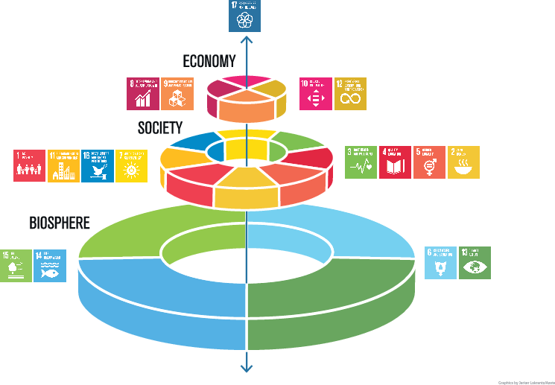



Measuring What Matters: SDG Mapping
UPO systematically maps all Third Mission activities and research publications to Sustainable Development Goals, creating transparent accountability and an evidence base for strategic decision-making.
Systematic Tagging
Every community engagement initiative and research project tagged to relevant SDGs for comprehensive impact tracking.
Evidence-Based Decisions
Clear data showing where progress is made and where gaps exist enables informed resource prioritization and strategic planning.
Transparent Reporting
Accountability to stakeholders, partners, and funders with demonstrable impact metrics aligned with Agenda 2030.
Attracting Partnerships
Measurement discipline attracts partners and investments aligned with global sustainability frameworks and impact goals.
Notes:
SDG wedding cake Image Credit: Azote for Stockholm Resilience Centre, Stockholm University CC BY-ND 3.0.
What gets measured gets managed—and what gets managed can be improved and scaled. UPO has implemented systematic SDG mapping of all our Third Mission activities and research publications. Every community engagement initiative, every applied research project, every partnership is tagged to the relevant Sustainable Development Goals.
This creates a clear, transparent mapping from our activities and results to Agenda 2030 targets. Why does this matter? First, it provides an evidence base for internal decision-making—we can see where we are making genuine progress, where gaps exist, and where to prioritize future investments. We can identify which SDGs receive abundant attention and which are underserved by our current portfolio.
Second, it enables us to identify successful models that should be replicated or scaled. When we see that a particular intervention consistently delivers measurable progress toward specific SDGs, we can invest in expanding that intervention or adapting it to new contexts.
Third, it provides transparent reporting to stakeholders, partners, and funders who increasingly demand demonstrable impact aligned with global frameworks. Universities are often criticized for engaging in sustainability activities that cannot be measured or verified. We have solved that problem through rigorous, transparent measurement aligned with internationally recognized frameworks.
This measurement discipline is essential for accountability and for attracting the partnerships and investments needed to amplify our work. It transforms sustainability from aspiration to evidence-based practice.

Slide 10
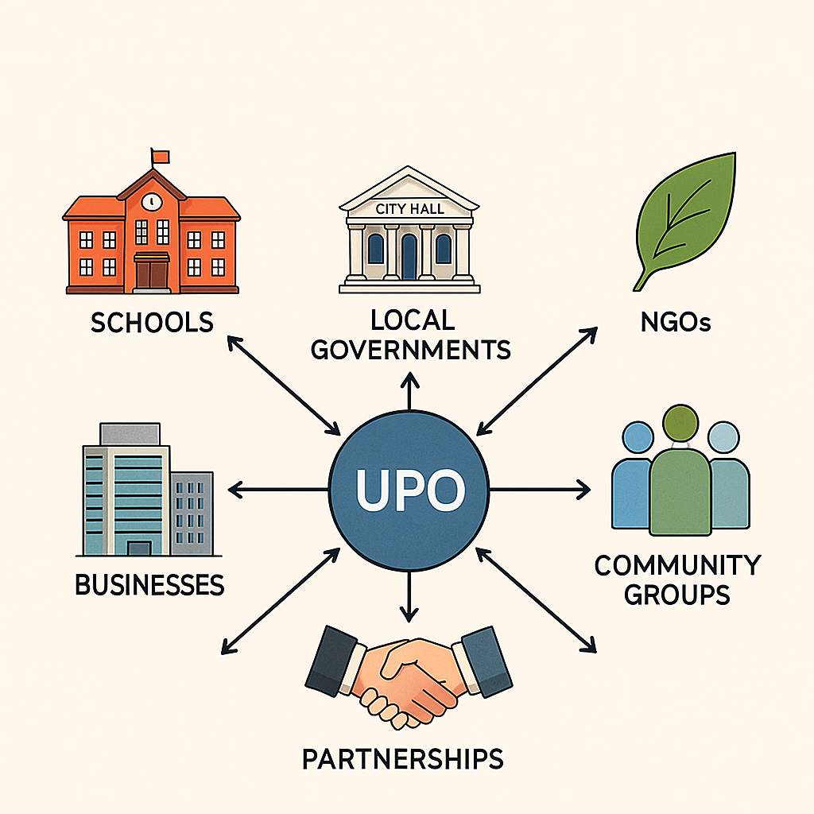




Partnerships to Multiply Impact
No single institution can deliver the transformation required for climate adaptation and mitigation. We multiply impact through partnerships that transcend institutional and national boundaries.
Scale RUS Model
Extend RUS/RUS Piemonte framework to cross-regional and cross-border alliances, creating communities of practice.
Co-develop NbS Pilots
Partner with cities, SMEs, and schools using open data and monitoring protocols for shared learning and interoperability.
Expand Circularity Desk
Network of support for SMEs transitioning to resilience and circularity through university expertise and collaborative tools.
Open Science Collaboration
Mobility programs and challenge-based projects with shared tools, indicators, and frameworks for systemic transformation.
Notes:
No single institution can deliver the transformation required for climate adaptation—we must work through partnerships that multiply impact. UPO is actively scaling our successful models through expanding networks.
We are extending the RUS and RUS Piemonte framework to cross-regional and cross-border alliances, creating communities of practice that transcend institutional and national boundaries. The peer learning model that works within Italy can work across Europe and globally.
We are co-developing nature-based solution pilots with cities, SMEs, and schools, using open data and monitoring protocols to ensure interoperability and shared learning. When multiple institutions use compatible measurement frameworks, we can aggregate findings and accelerate the evidence base for what works.
We are expanding the Circularity Desk network so that more enterprises can access university expertise for their sustainability transitions. Imagine a network of universities across Europe, each operating a Circularity Desk that shares tools, methodologies, and lessons learned—the collective impact would be transformative.
We are creating mobility programs and challenge-based projects tailored to local adaptation priorities while building global connections. Students and researchers can move between partner institutions, bringing fresh perspectives and building the international networks that will sustain collaboration for decades.
This is an open invitation to international partners: join us in co-creating nature-positive, resilient pathways. We have developed tools, indicators, and frameworks designed for sharing. The climate crisis demands open science and collaborative action. Universities must lead by example, breaking down competitive barriers to create the collaborative infrastructure needed for systemic transformation.

Slide 11




Universities as Strategic Actors
in the Transition
Climate adaptation and mitigation require collective action and societal learning—precisely the domains where universities have comparative advantage and institutional mission.
Build Green Skills
Test Nature-Based Solutions
Grow Culture of Sustainability
Prepare new generations to manage change and seize opportunities in the emerging green economy through interdisciplinary education.
Generate evidence for scaling through research infrastructure and living laboratories that prototype and monitor interventions.
Reduce polarization and strengthen social capital for collective action through engagement that shifts norms and builds capacity.
Knowledge + Cooperation = Pathway to Agenda 2030
Notes:
Universities help society look beyond short-term individual interests toward long-term collective well-being.
Only through knowledge and cooperation can we implement Agenda 2030, adapt to climate change, and commit to meaningful mitigation.
Let me conclude with the central argument: universities play a strategic role in the ecological transition now more than ever. Climate adaptation and mitigation require collective action and societal learning—precisely the domains where universities have comparative advantage and institutional mission.
We build green skills through education that prepares new generations to manage change and seize opportunities in the emerging green economy. We test nature-based solutions through research infrastructure and living laboratories that generate evidence for scaling. We grow a culture of sustainability through engagement that reduces polarization and strengthens social capital for collective action.
Universities help society look beyond short-term individual interests toward long-term collective well-being. In an era of short political cycles and quarterly earnings reports, universities maintain focus on generational timescales. We strengthen engagement across all fronts—education, research, community partnerships, business collaboration, and policy advice.
Only through knowledge and cooperation can we increase the chances of implementing Agenda 2030, adapting to climate change, and committing to meaningful mitigation. Universities must embrace this strategic role and work collaboratively across institutional and national boundaries to deliver the transformation our planet urgently needs.
The examples I have shared today—from network building to interdisciplinary education, from the Circularity Desk to the UPO Forest, from experiential learning to systematic measurement—demonstrate that this is not abstract aspiration. It is concrete practice, grounded in evidence, designed for replication and scaling.

Slide 12



Join Us in Co-Creating Resilient Pathways!
Research Collaboration
Student & Faculty Exchange
Knowledge Sharing
Joint projects on nature-based solutions, climate adaptation and mitigation, and sustainability transitions
Mobility programs connecting our living laboratories and field research sites
Open tools, frameworks, and lessons learned for collective climate action
Università del Piemonte Orientale (UPO)
Carmen Aina | RUS Piemonte Chair (2023–2026) Department for Sustainable Development and Ecological Transition www.uniupo.it | carmen.aina@uniupo.it
Notes:
The models we've shared—RUS networks, GASS education, Circularity Desk, UPO Forest, and Tipping Points—demonstrate that universities can be powerful engines of transformation.
We invite you to collaborate in replicating and adapting these approaches to your contexts.
Thank you for your attention. The examples I have shared today—from the RUS network to the GASS program, from the Circularity Desk to the UPO Forest, from Tipping Points to systematic SDG mapping—demonstrate that universities can be powerful engines of transformation when we embrace our strategic role in the ecological transition.
But we cannot do this alone. I invite you to collaborate with us in replicating and adapting these models to your contexts. We are open to partnerships for research, education, and implementation. Our tools, frameworks, and lessons learned are available for sharing because the climate crisis demands open collaboration rather than competitive advantage.
Please connect with us to explore how we can work together to co-create nature-positive, resilient pathways that deliver Agenda 2030 and prepare our societies not just to survive climate change, but to lead the transformation toward a sustainable future.
You can reach me at the University of Eastern Piedmont. I serve as Chair of RUS Piemonte for the 2023–2026 term and work within our Department for Sustainable Development and Ecological Transition. Our website is www.uniupo.it and you can contact us at sustainability@uniupo.it.
Thank you to the COP30 organizers for this opportunity, and I look forward to our continued collaboration in the critical work ahead. Together, through knowledge and cooperation, we can deliver Agenda 2030.

