Slide 1




Maurizio TIRA
Universities for Adaptation: nature-based solutions and skills for resilience
Italy Pavilion
November 15th 2025
University of Brescia – European University Association (EUA)
Sustainability and greening at higher education institutions

Slide 2
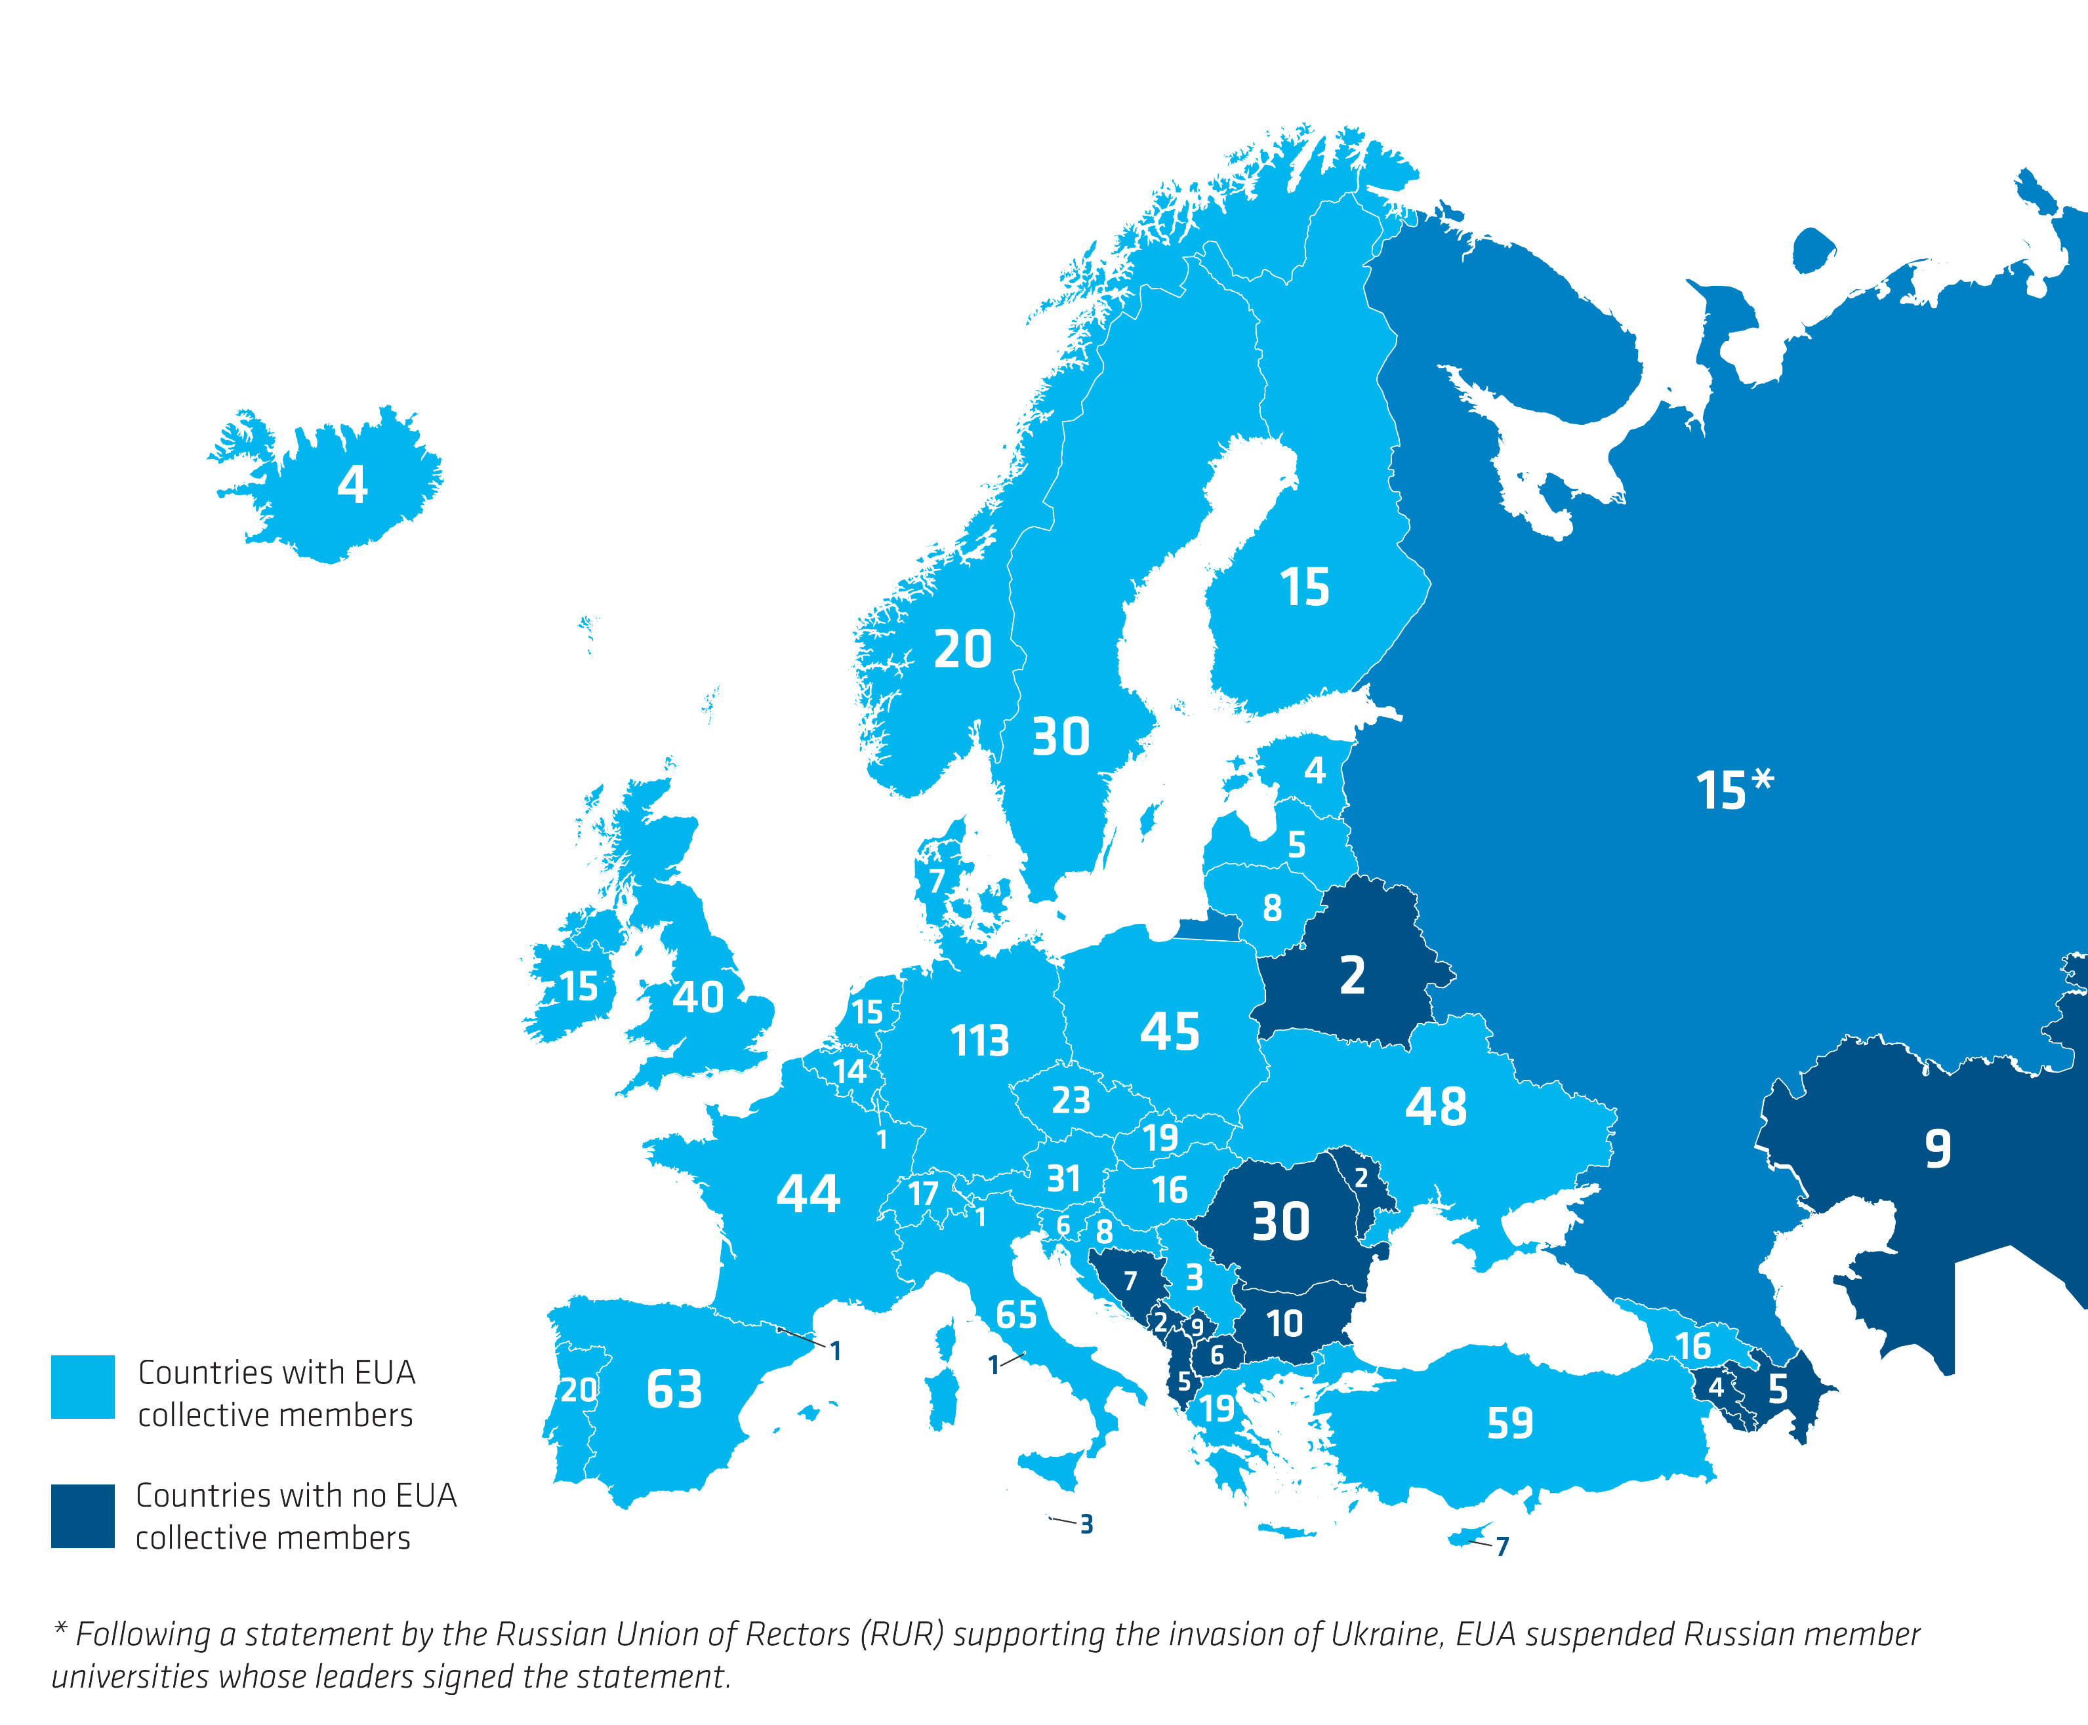
EUA has 918 members
based in 48 countries
(as of 31 January 2025)

Slide 3
Main objectives
      Facilitates dialogue on higher education & research
      Represents the interests of higher education sector
      Ensures the voice of universities is heard in EU policy making & in the EHEA
      Support its members with a range of services (strategy development, thematic peer groups & focus groups, events and publications)

Slide 4
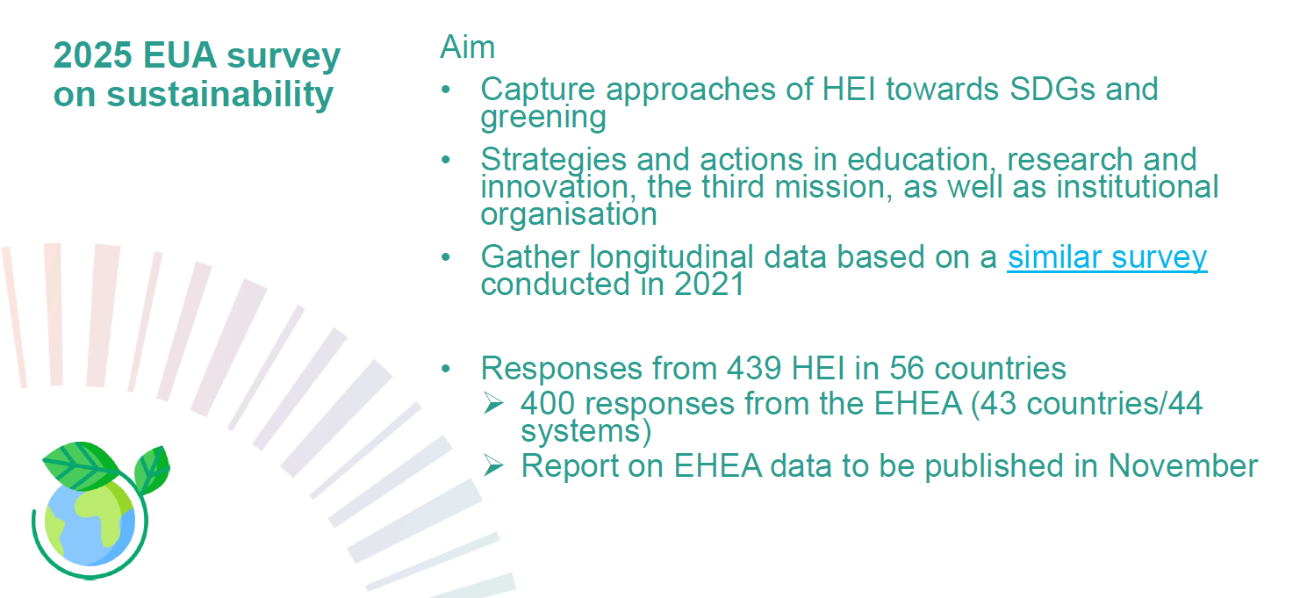

Slide 5
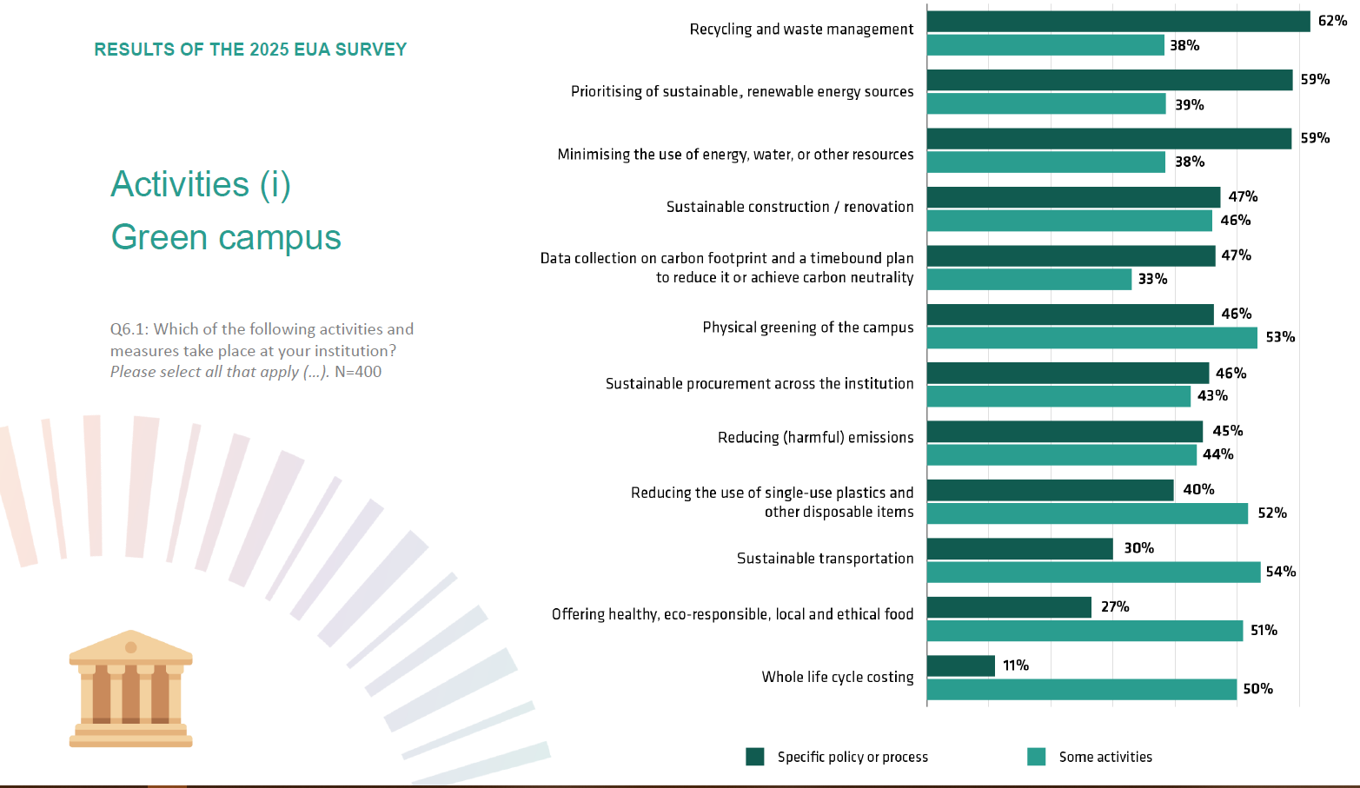

Slide 6
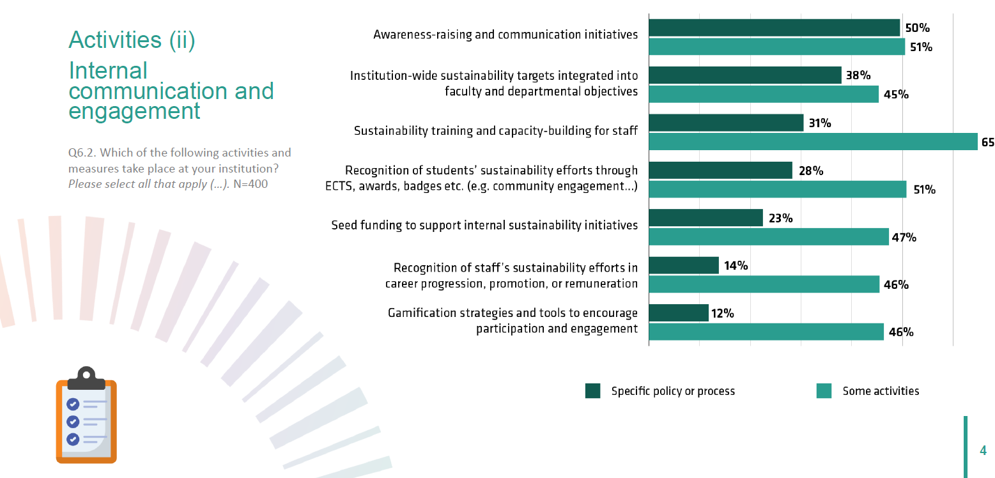

Slide 7
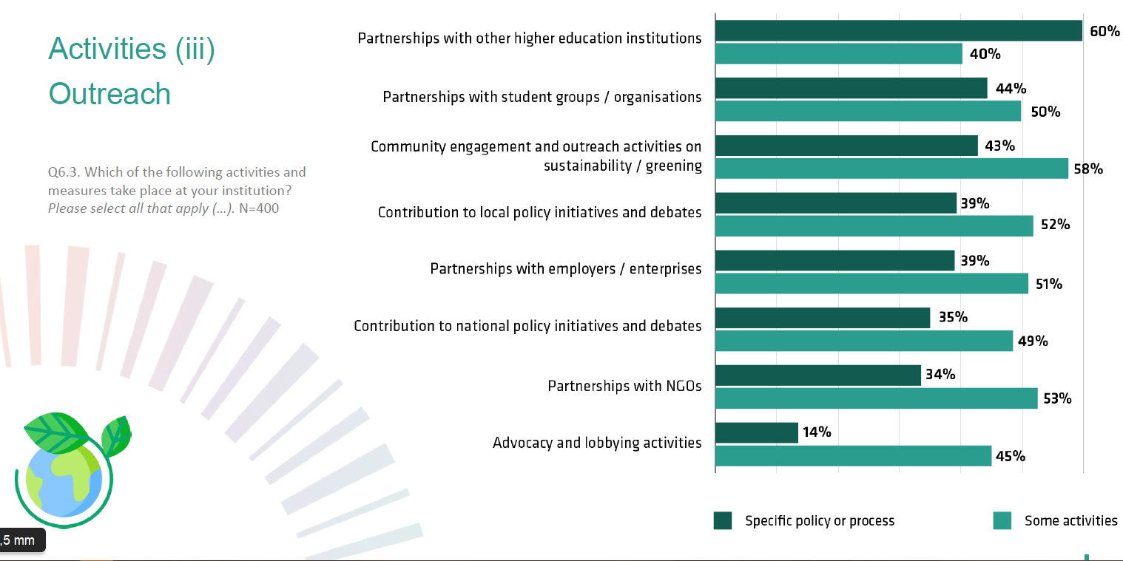

Slide 8
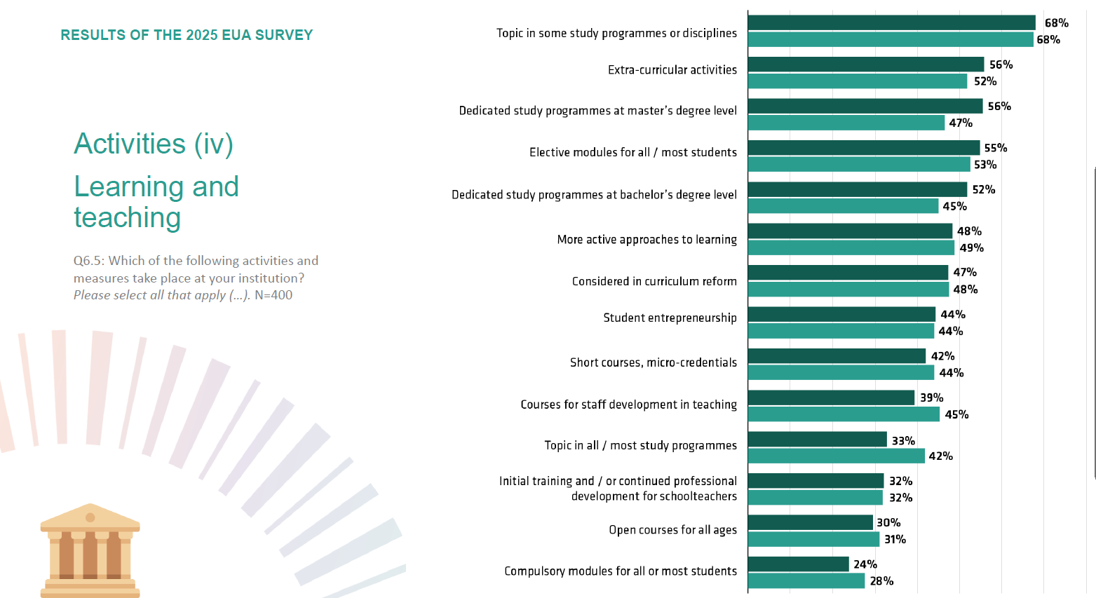

Slide 9
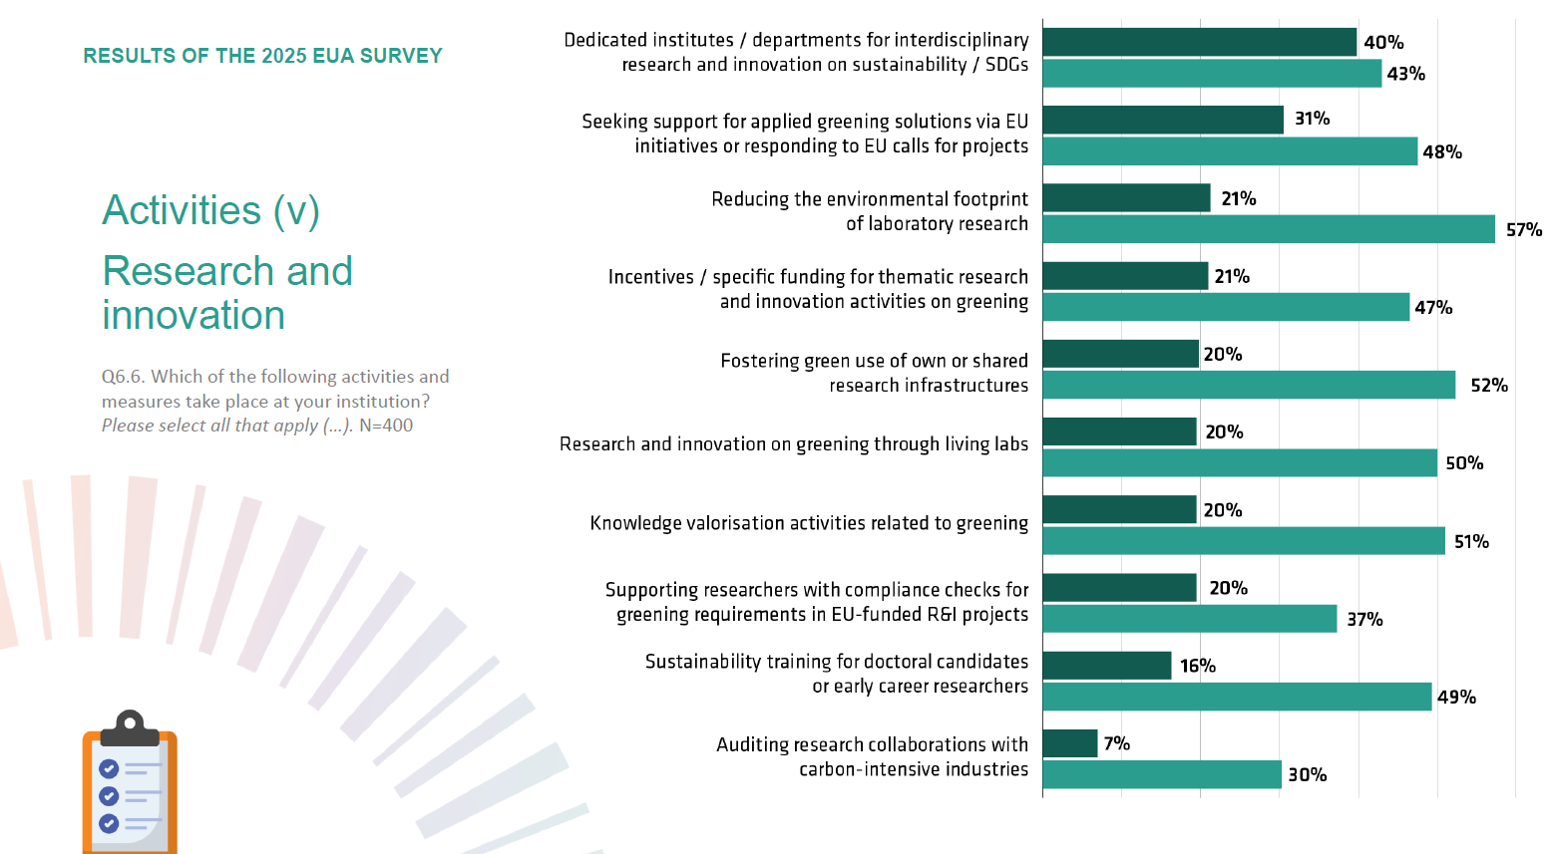

Slide 10
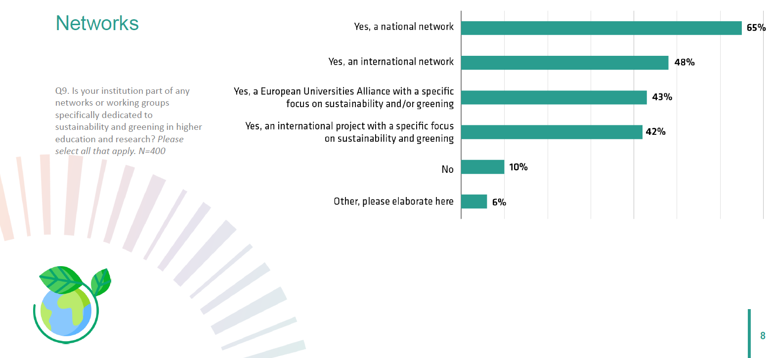

Slide 11
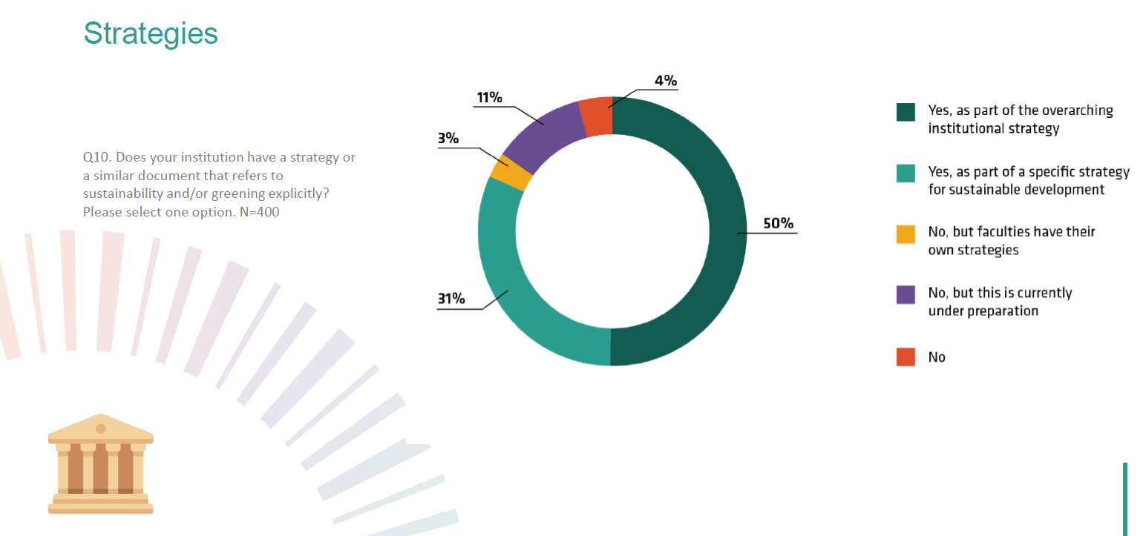

Slide 12
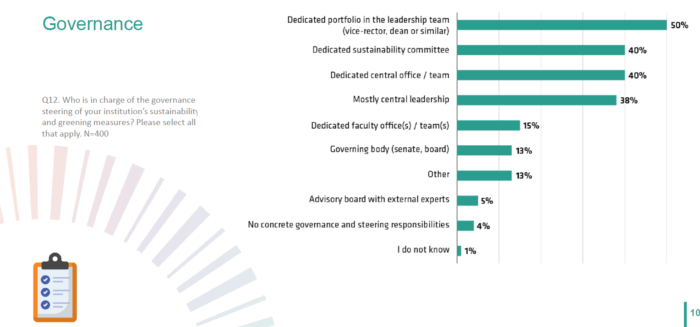

Slide 13
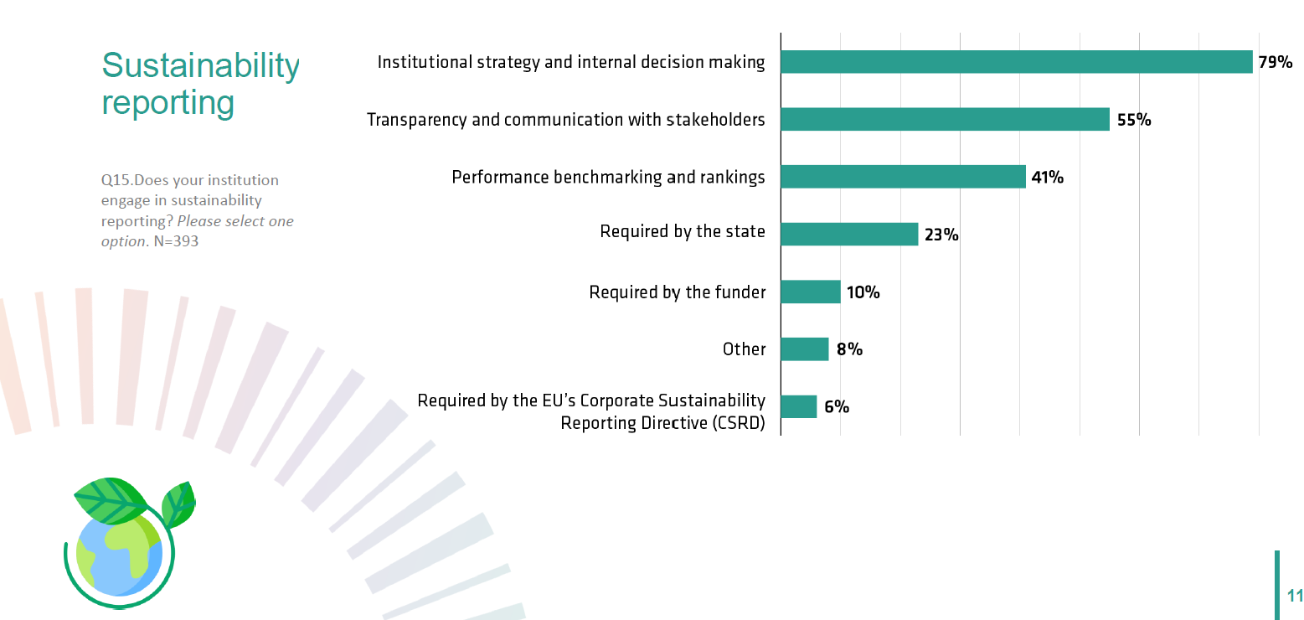

Slide 14
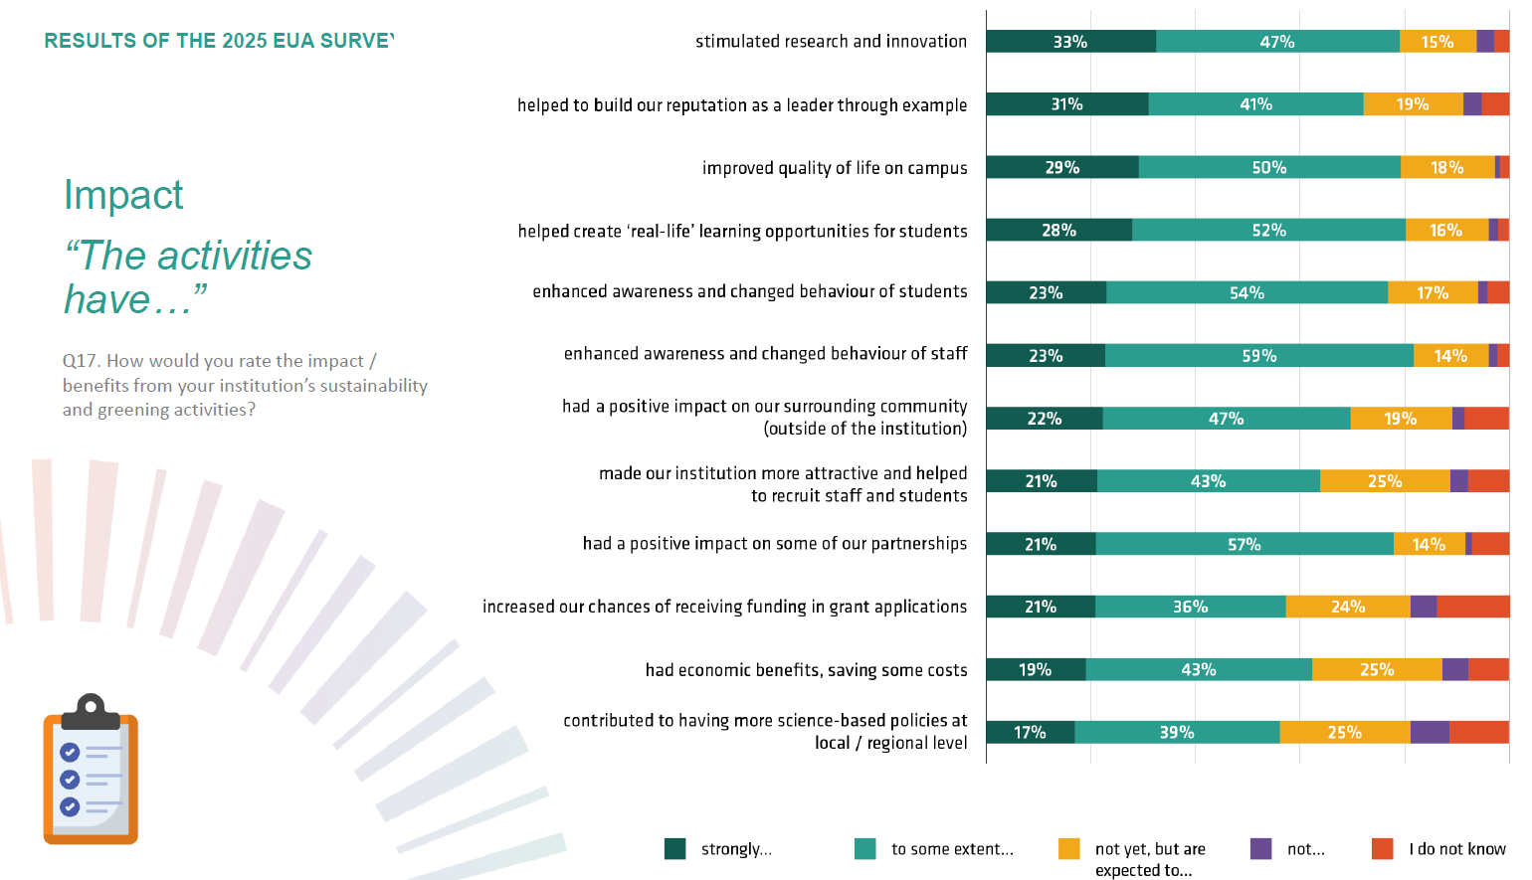

Slide 15
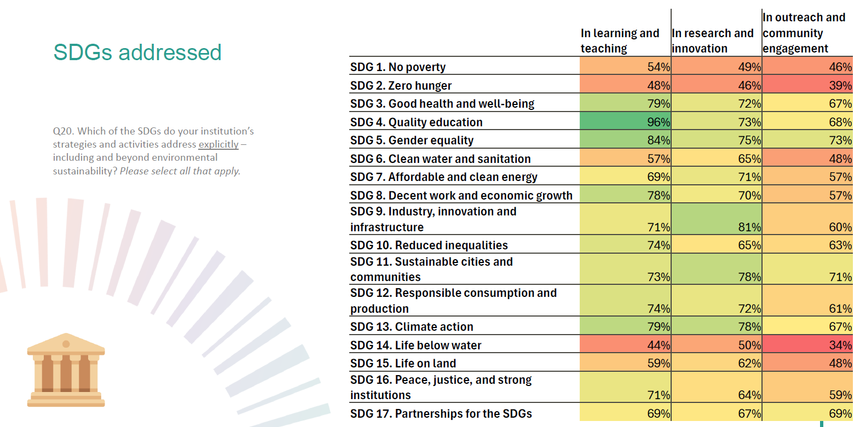

Slide 16
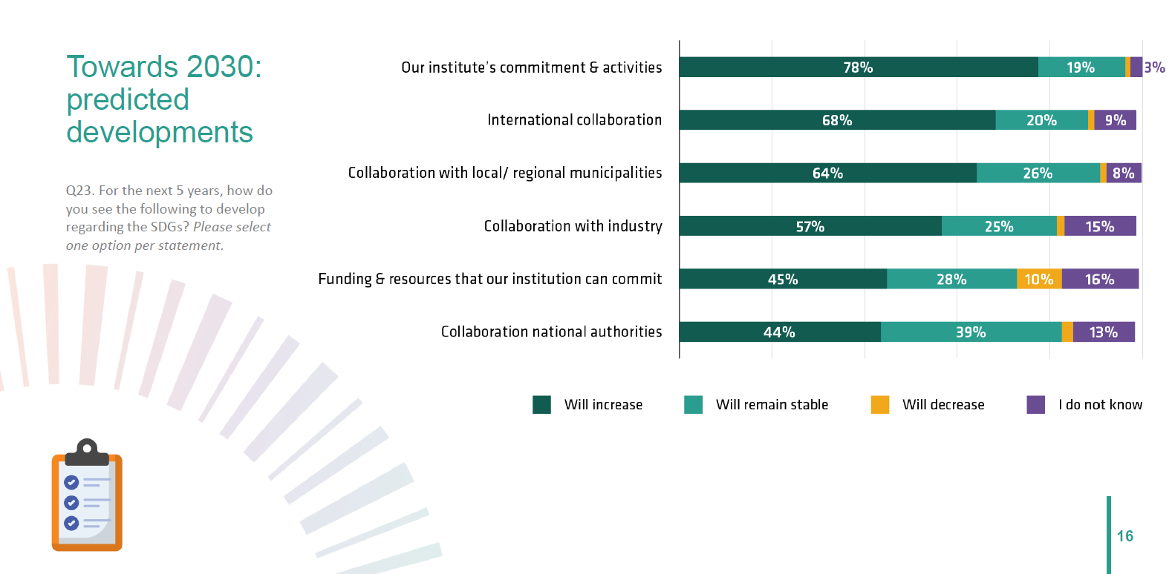

Slide 17

Many diverse activities, across all university missions
Increase in explicit strategies (61% in 2021 to 84% in 2025)
Trend to establish dedicated leadership portfolios (38% to 50%)
Clear link to university’s values, and its role as an actor in society
Multifaceted benefits:
  Improved campus-life (79%)
  Stimulates R&I (80%) and “real life” L&T opportunities (80%)
  Attractive institution re student/staff recruitment (64%, and 25% expect future gains)
  Economic benefits and cost savings (62%, and 25% expect future gains)
Lack of funding and funding incentives are main barriers
Beyond greening, trends towards addressing several other SDGs, in particular in L&T activities
HEIs engagement for and with SDGs likely to grow further
Sustainability and greening at HEIs in 2025
Notes:
Activities: see the long ppt shared
Strategies: In 2025, 84% of HEIs have strategies in place that refers to sustainability and/or greening explicitly, and 11% are currently preparing one. This is a major increase compared to 2021, when 61% of institutions had a strategy, and another 25% planned to develop one.
Leadership: Almost all HEIs (95%) have concrete governance and steering mechanisms in place for the institution’s sustainability and greening measures. Since 2021, there has been an increase especially in the number of HEI that have a dedicated leadership portfolios (vice-rector, dean or similar) in place (from 38% to 50%).
Values: Values and engagement are the main drivers of for sustainability and greening: Almost all institutions rate the links to their institutional values as either very important (66%) or important (33%).
Benefits: see data on slide
Barriers: The most frequently mentioned challenges and barriers to environmental sustainability activities are largely the same as in 2021: lack of funding and lack of engagement by the members of the institution. But whereas the institution’s strategic management is still a challenge, it no longer is a top 5 concern.
Beyond greening: Many institutions’ strategies address the SDGs beyond their environmental aspects, with a global approach, but also discernible focus on of immediate impact for themselves and their societal surrounding. Interestingly, strategic approaches for SDGs are most prevalent in learning and teaching, followed by research and innovation and lastly third mission and community engagement. Across all university missions, the three most likely SDGs to be addressed in institutional strategies and activities are SDG 4. Quality education (on average across all missions addressed by 79%), SDG 5. Gender equality (77%) and SDG 13. Climate action (75%), closely followed by SDG 11, Sustainable cities and communities (74%).
HEI engagement: Most respondents expect their institutions’ commitments to the SDGs by their institution to continuously grow in the next five years. The majority expect additional or enhanced activities (78%), as well as increased collaboration at international (68%) local/regional (64%) levels, as well as with industry (57%). The outlook for national level engagement is less positive: while 44% predict increases, 39% fear that collaboration with national authorities will remain stable at best.

Slide 18
maurizio.tira@unibs.it
Thank you for your attention
A special thanks goes to:
Thomas Jorgensen
Liliya Kukuruza
Henriette Stoeber

